Slide 1
The Beauty of Modified Stems

Slide 2
Outline
All structures come from plants known as geophytes, and are adapted to periodically harsh climates.
Spend a portion of their life cycle as a quiescent underground structure
Groups
  Bulbs, Corms, Tubers, Tuberous Stems and Roots, Rhizomes, and Pseudobulbs
  We will be propagating bulbs, corms, rhizomes, tubers, and tuberous stems
We have limited time, so buckle up and let’s ride!

Slide 3
Bulbs: Lily and Amaryllis
Short, fleshy, compressed stem axis with a basal plate, surrounding by scales (modified leaves)
Two types: tunicate and non-tunicate
How do these plants propagate themselves?
  New bulbs grow from nodes as outer scales decay
  We are speeding up this fundamentally similar process!
Scaling, twin-scaling, chipping

Slide 4
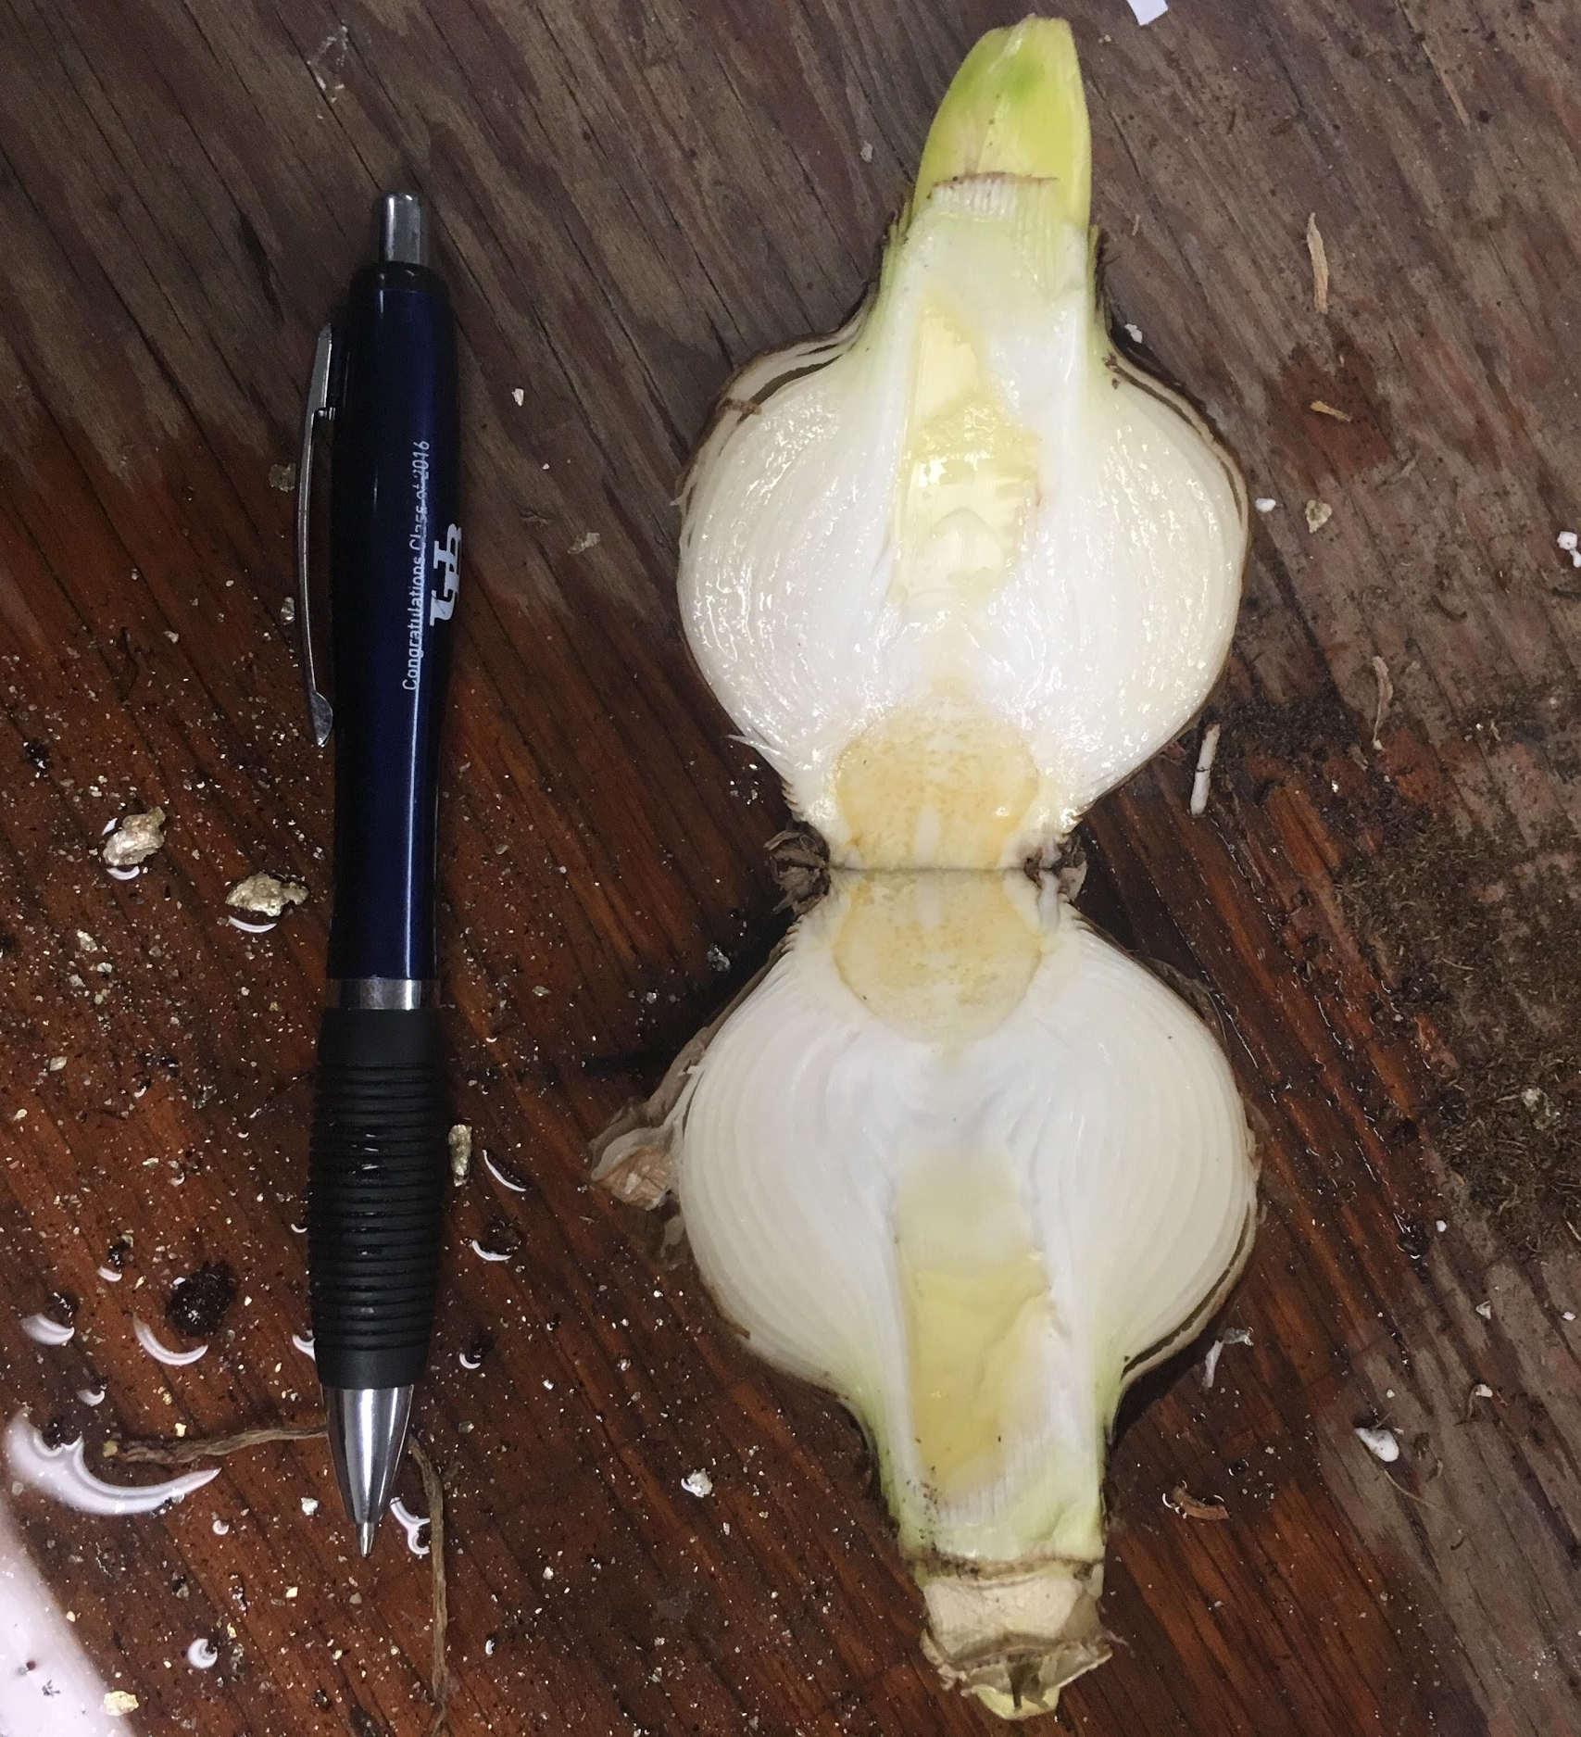

Slide 5
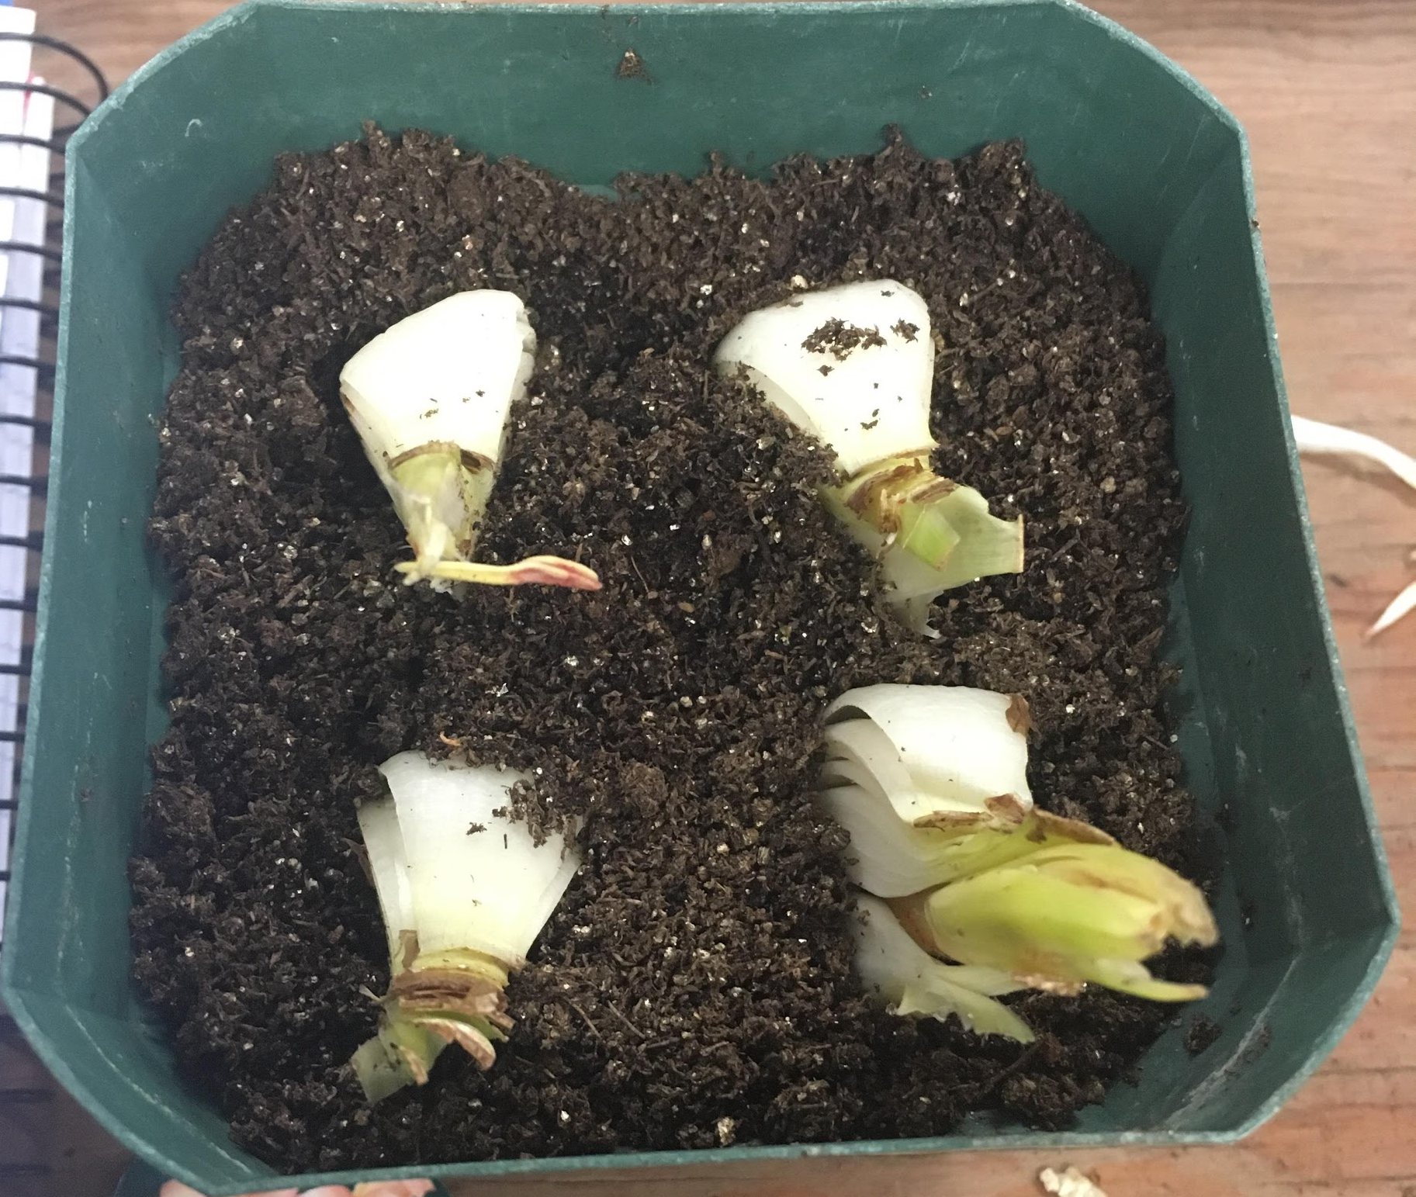

Slide 6
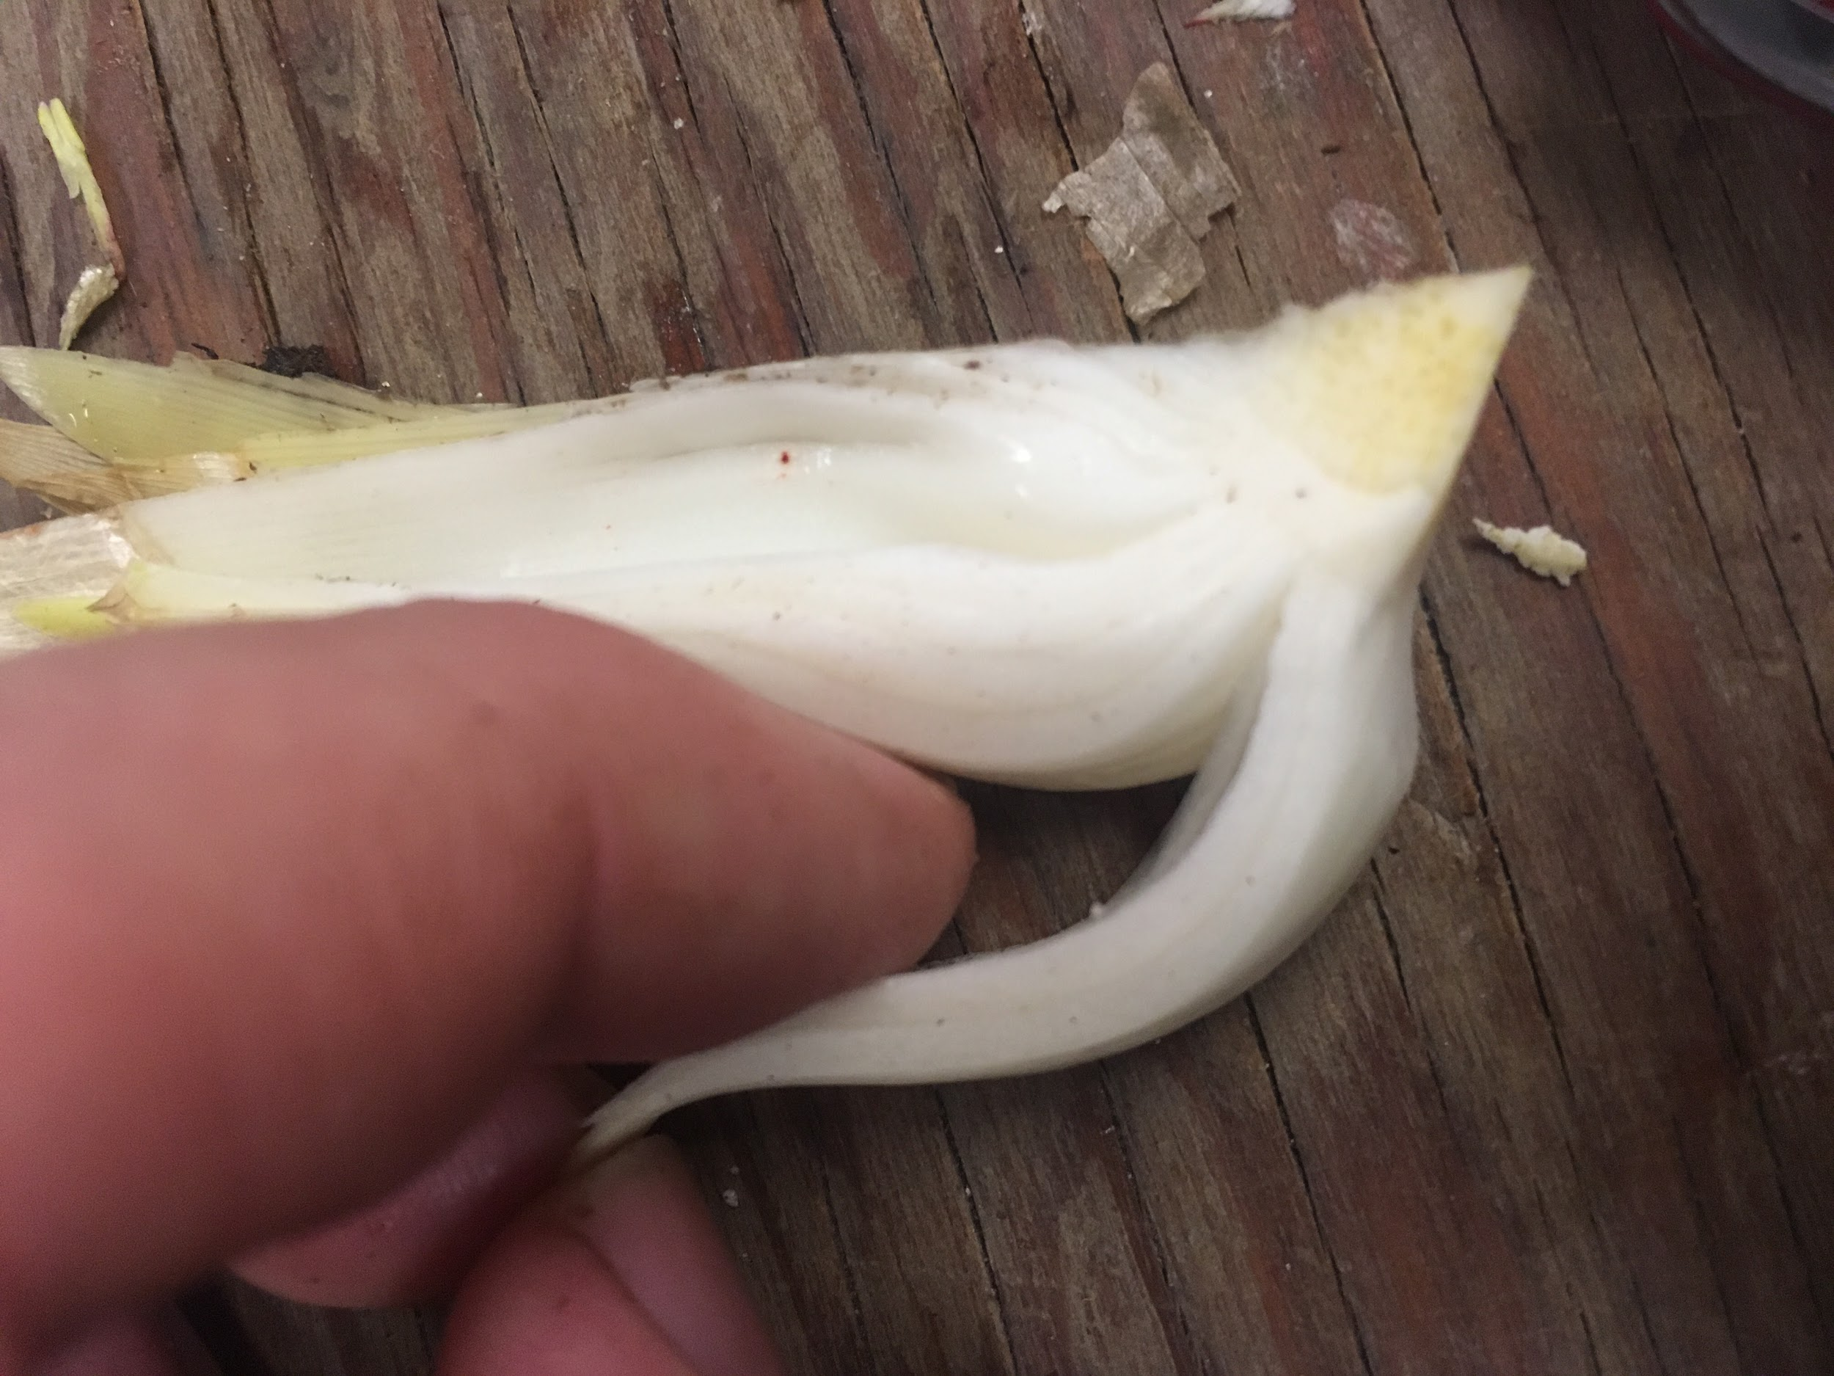

Slide 7
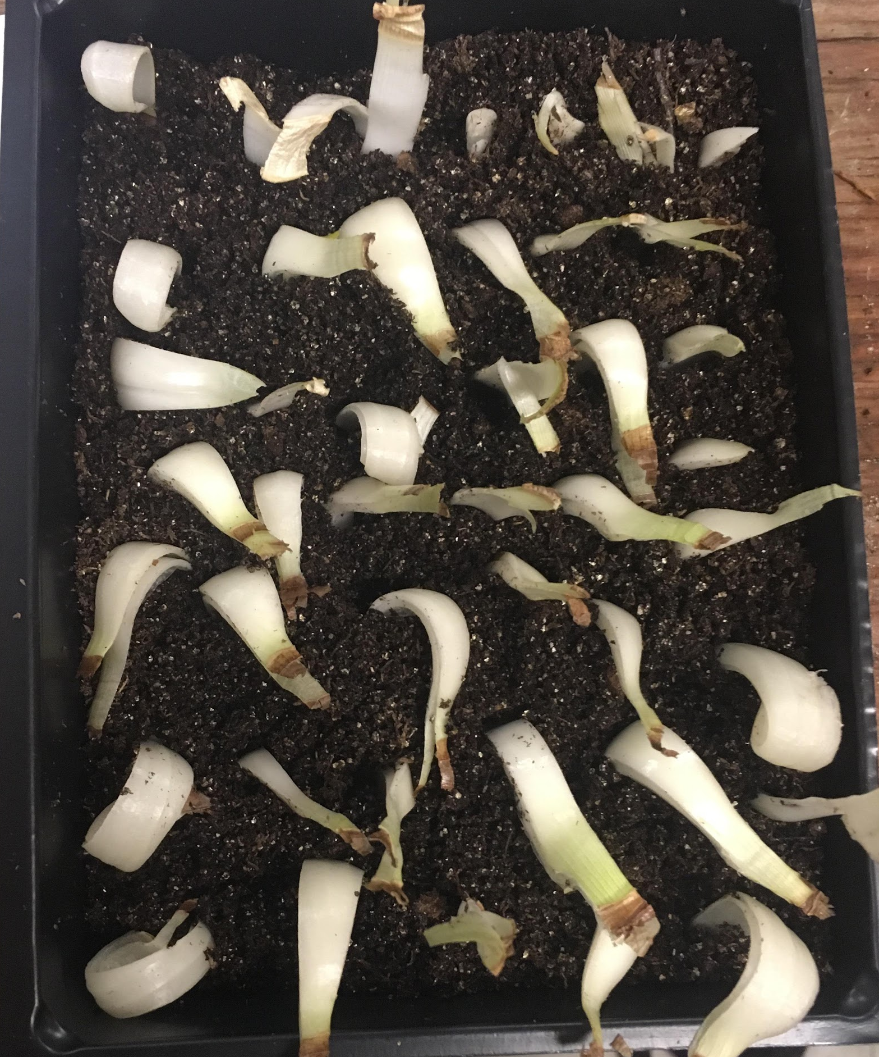

Slide 8
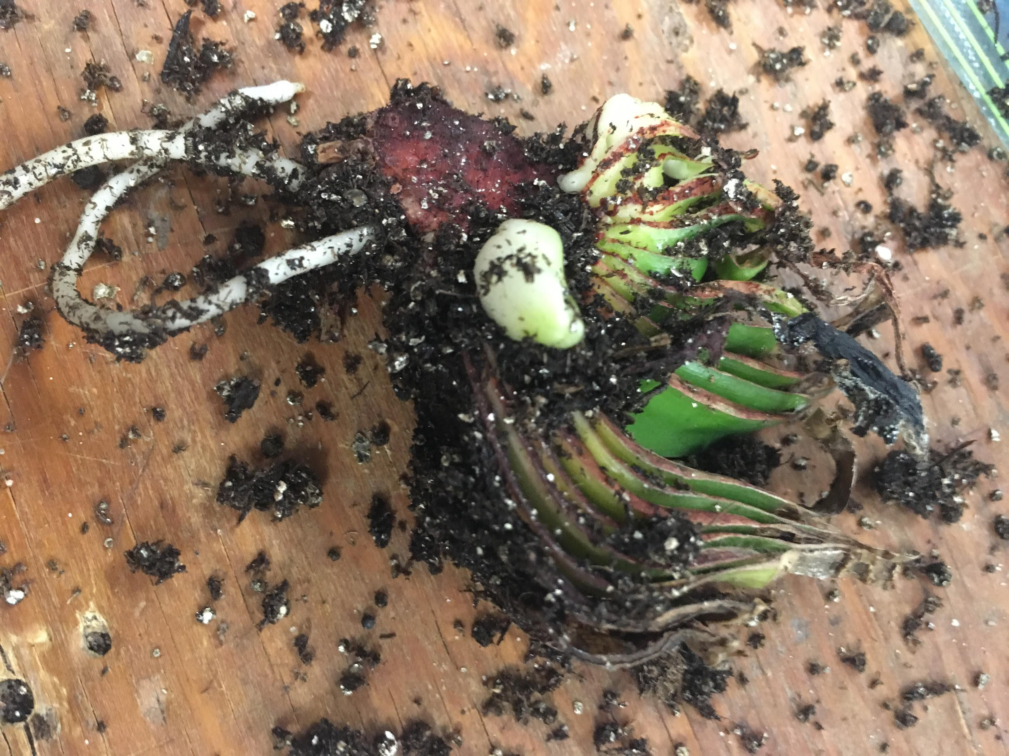

Slide 9
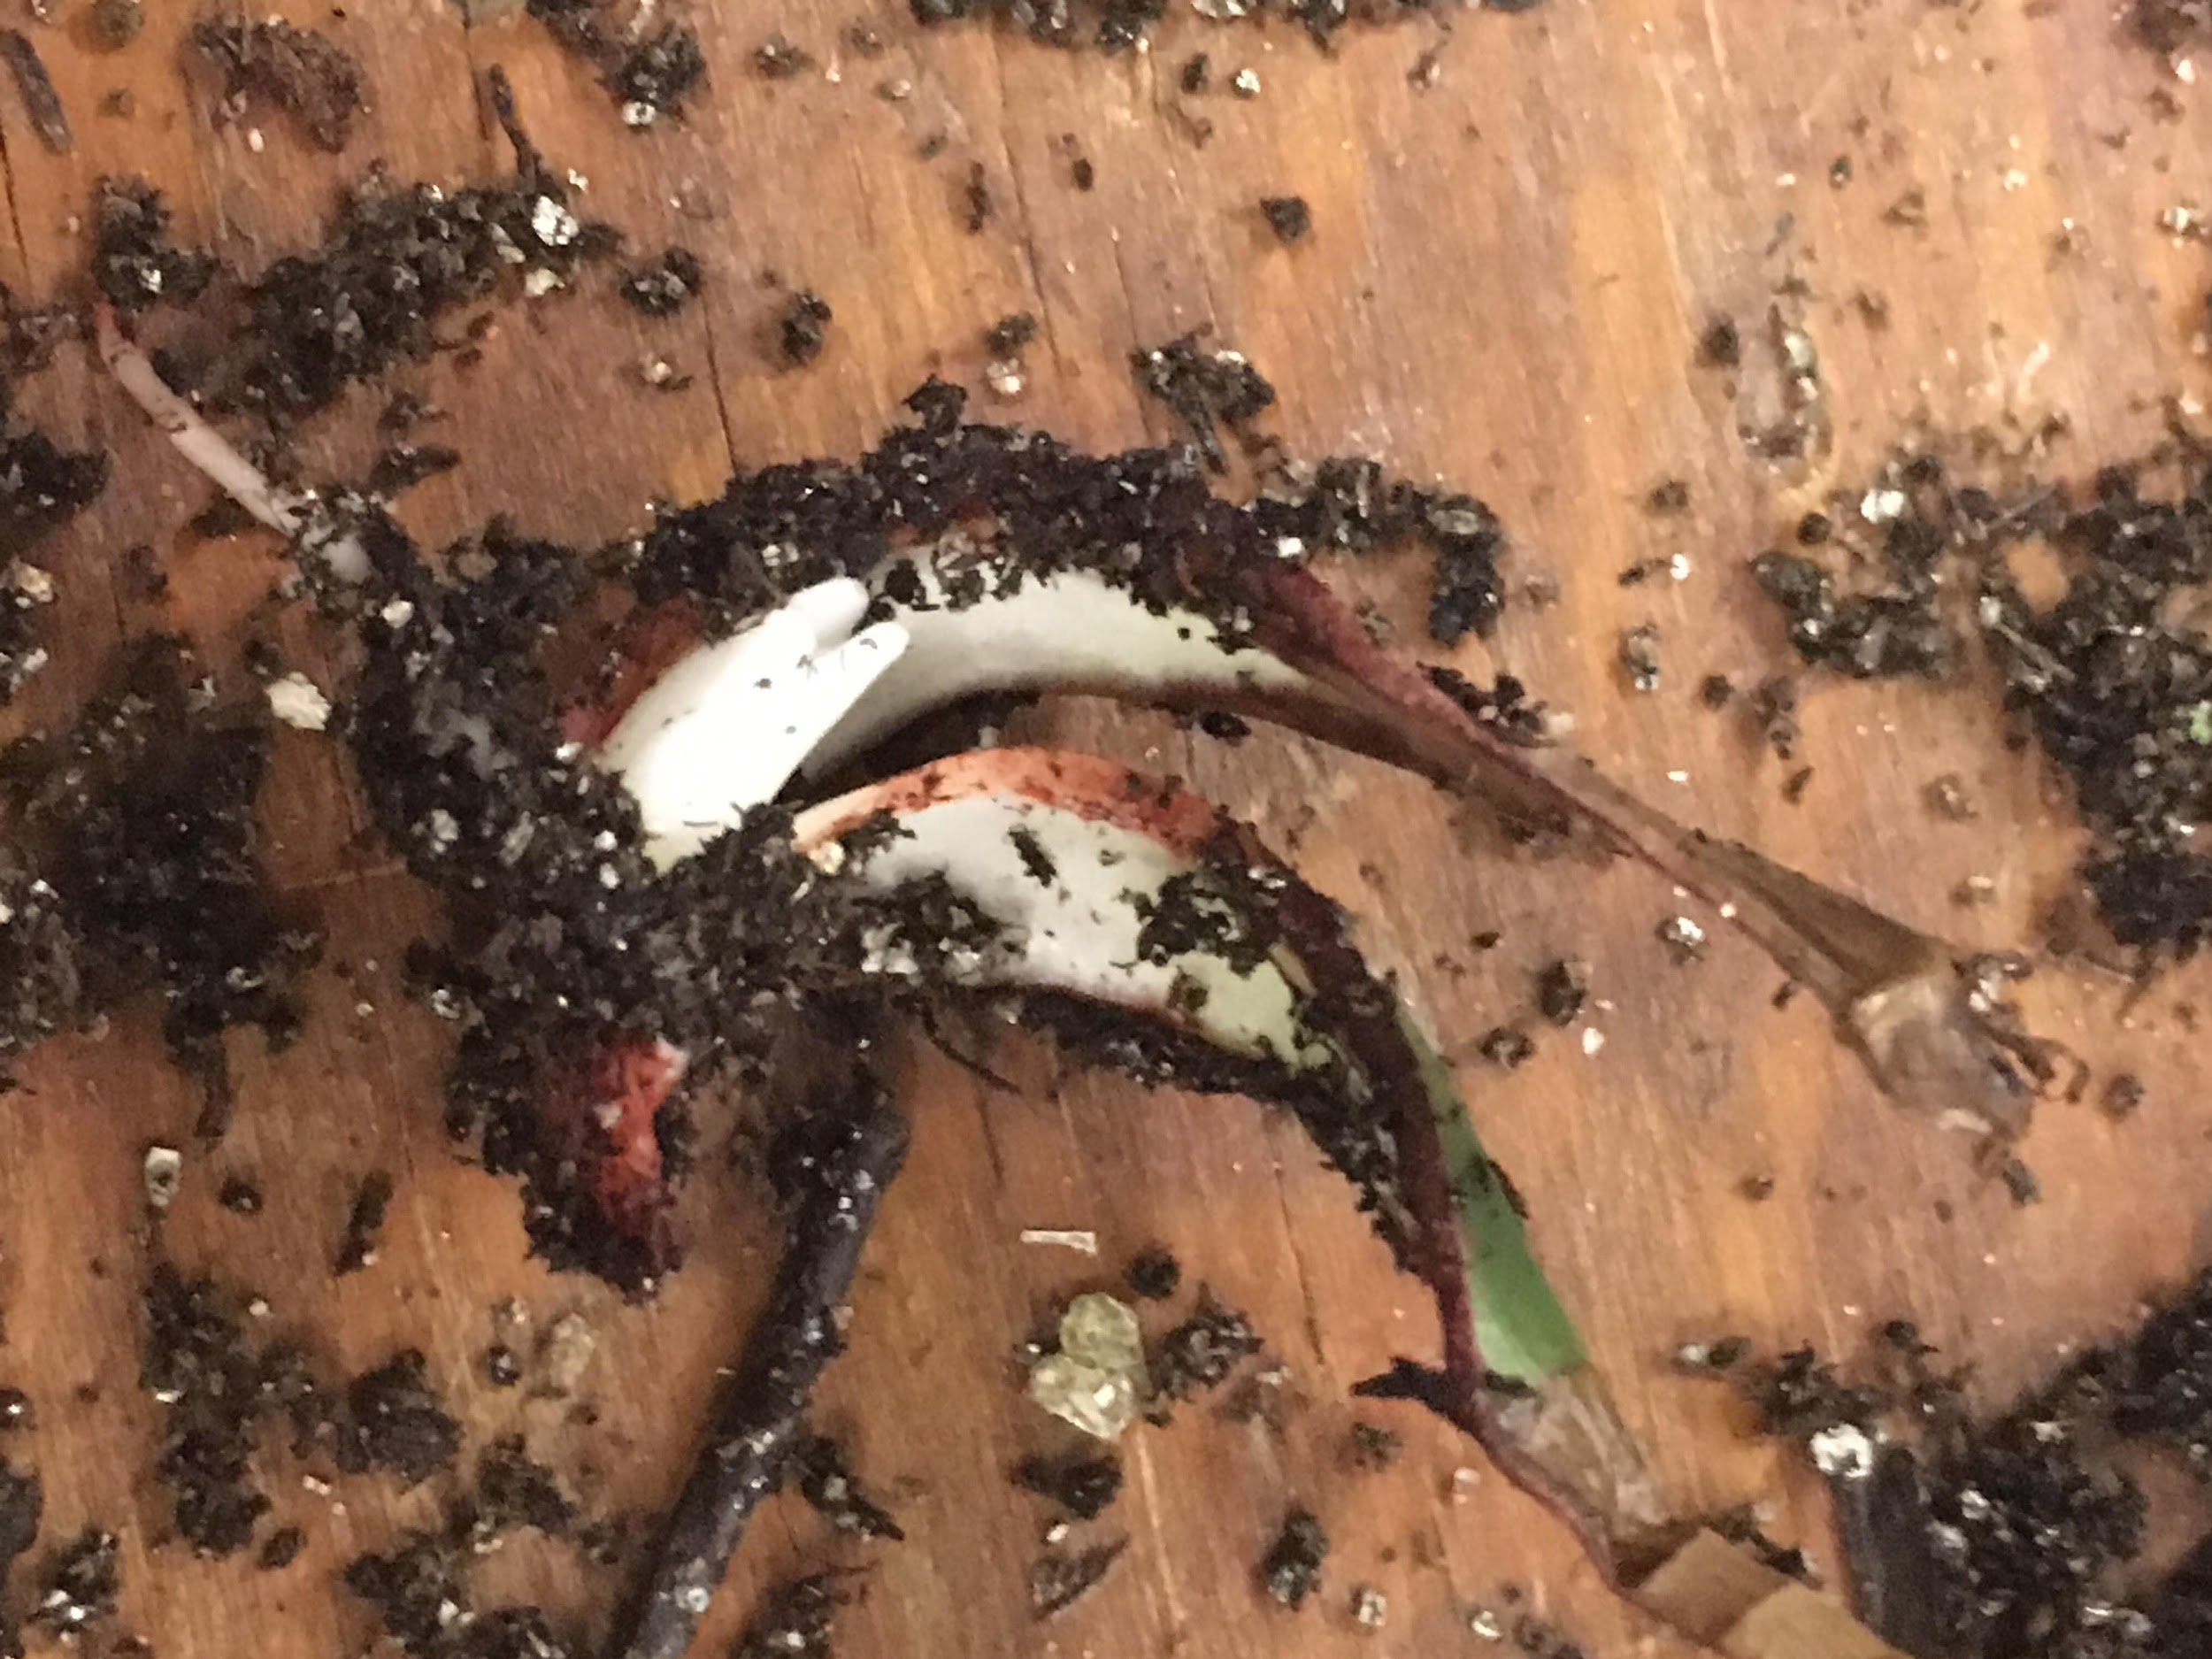

Slide 10
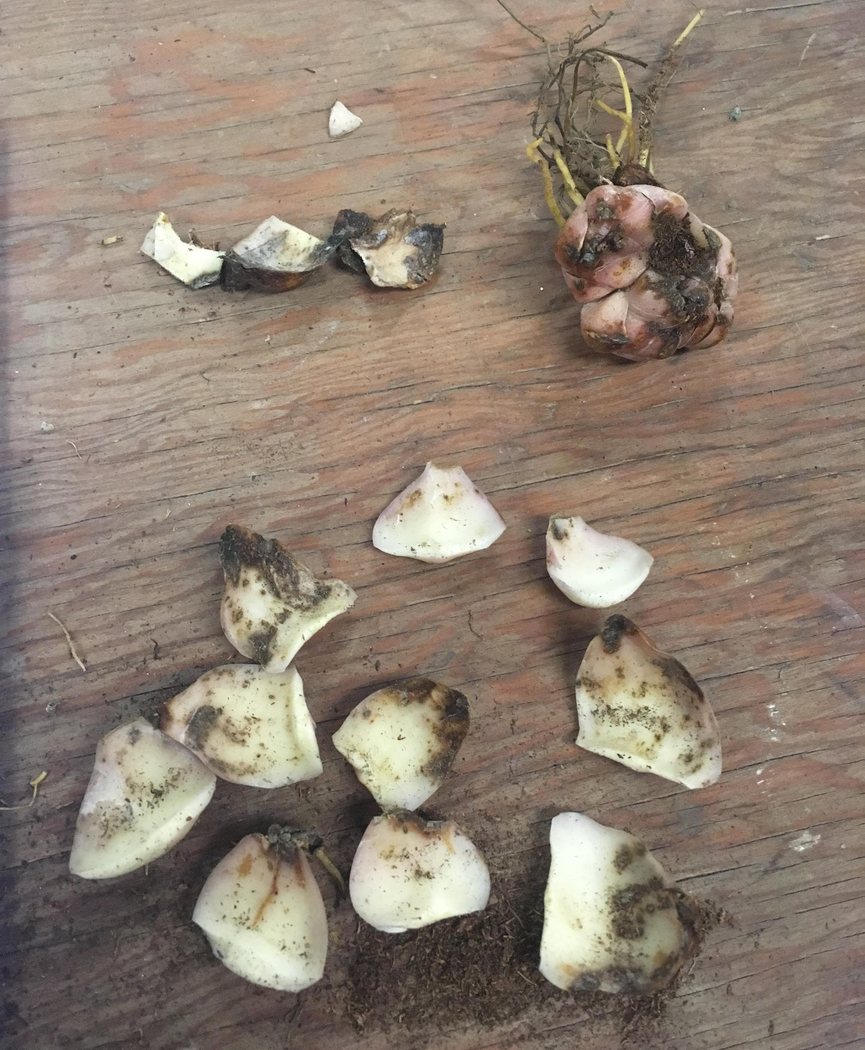

Slide 11
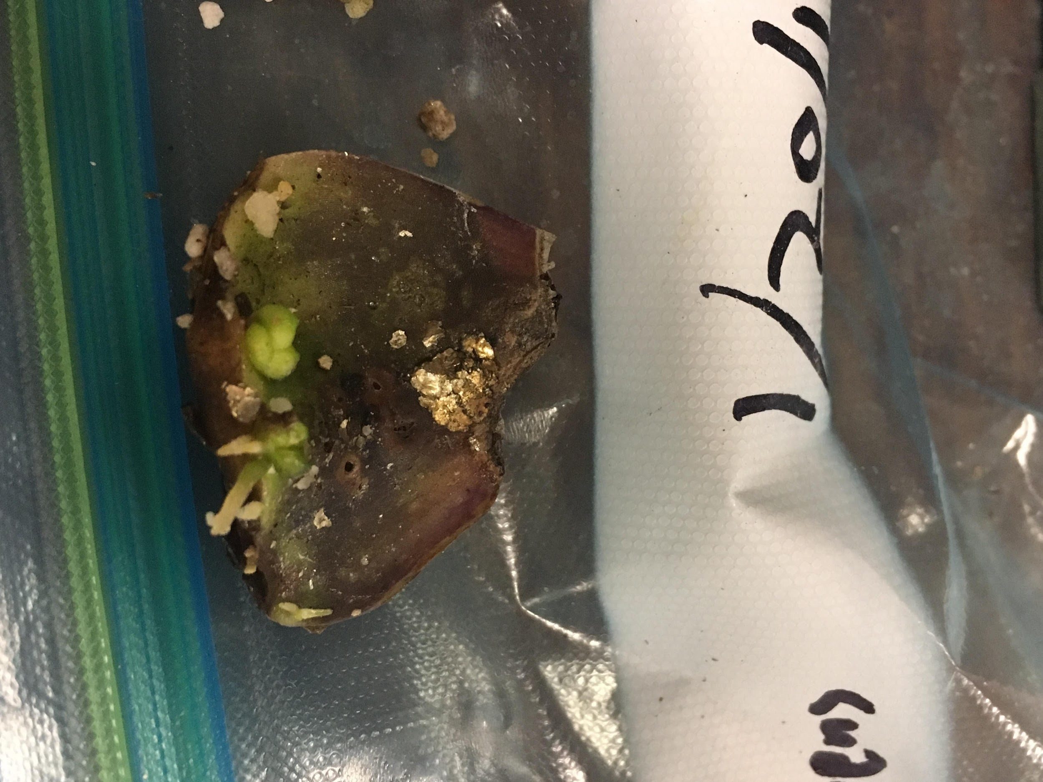

Slide 12
Corms: Gladiolus
Swollen stem bases with distinct nodes and internodes, as well as a basal plate, and a dry tunic
Self-propagation by cormels and new corm formation
Commercially propagated by chipping

Slide 13
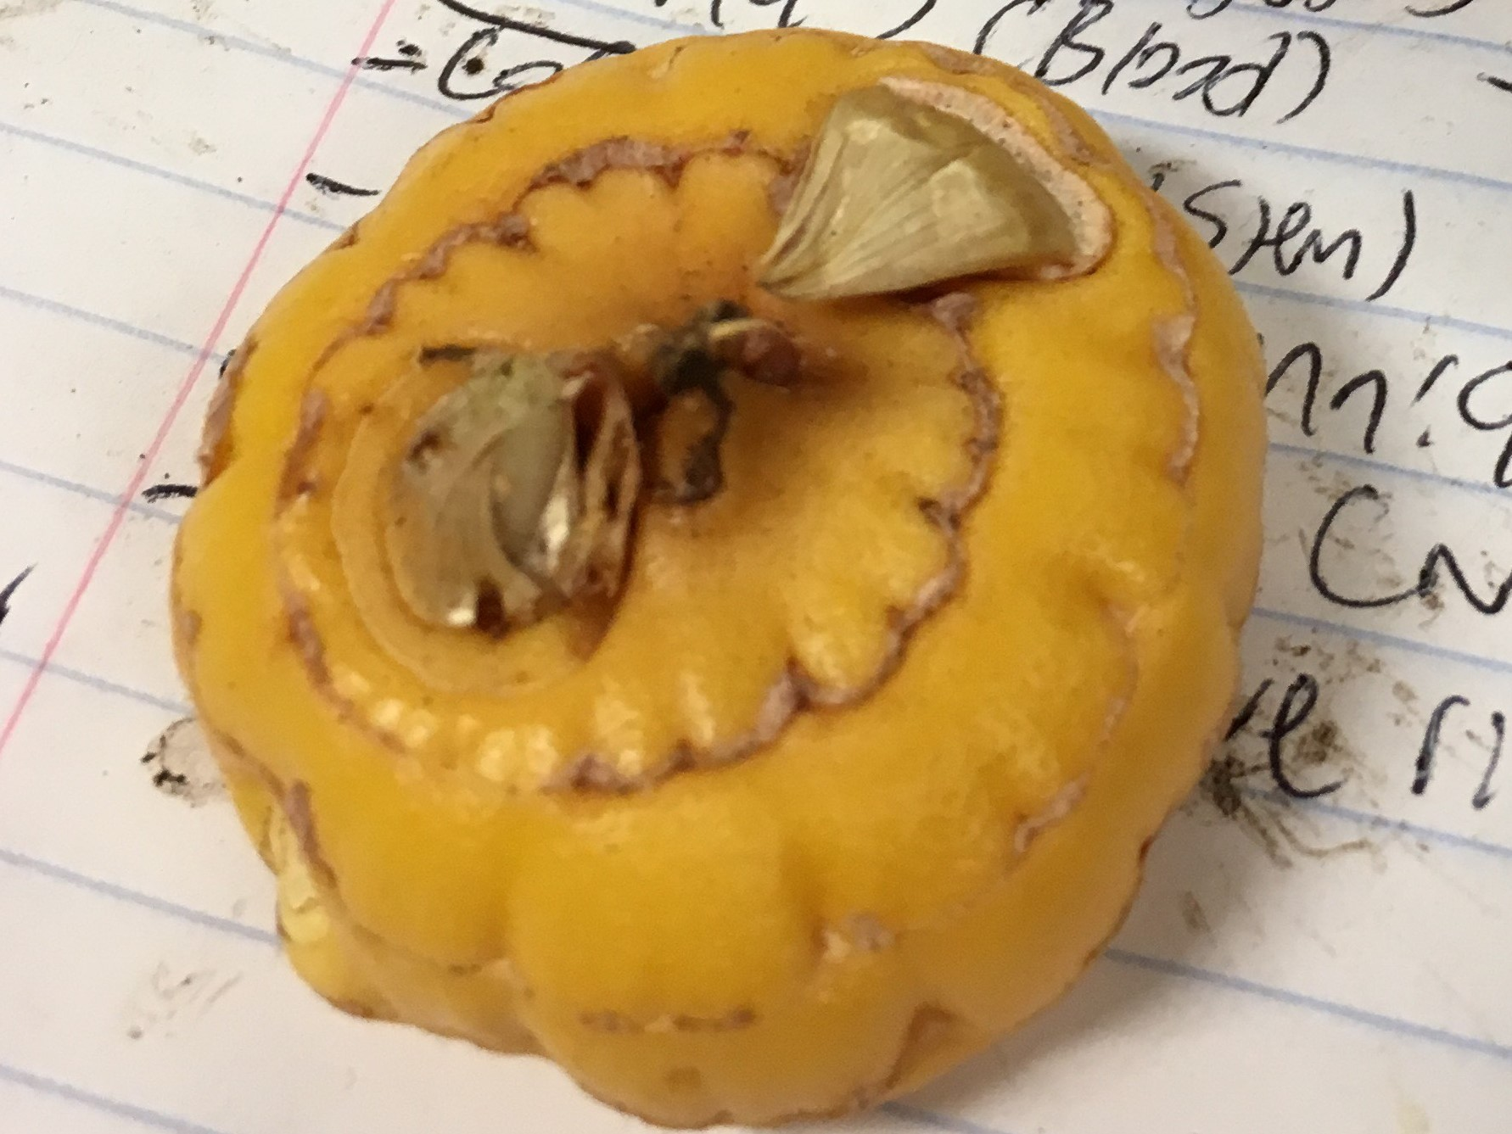

Slide 14
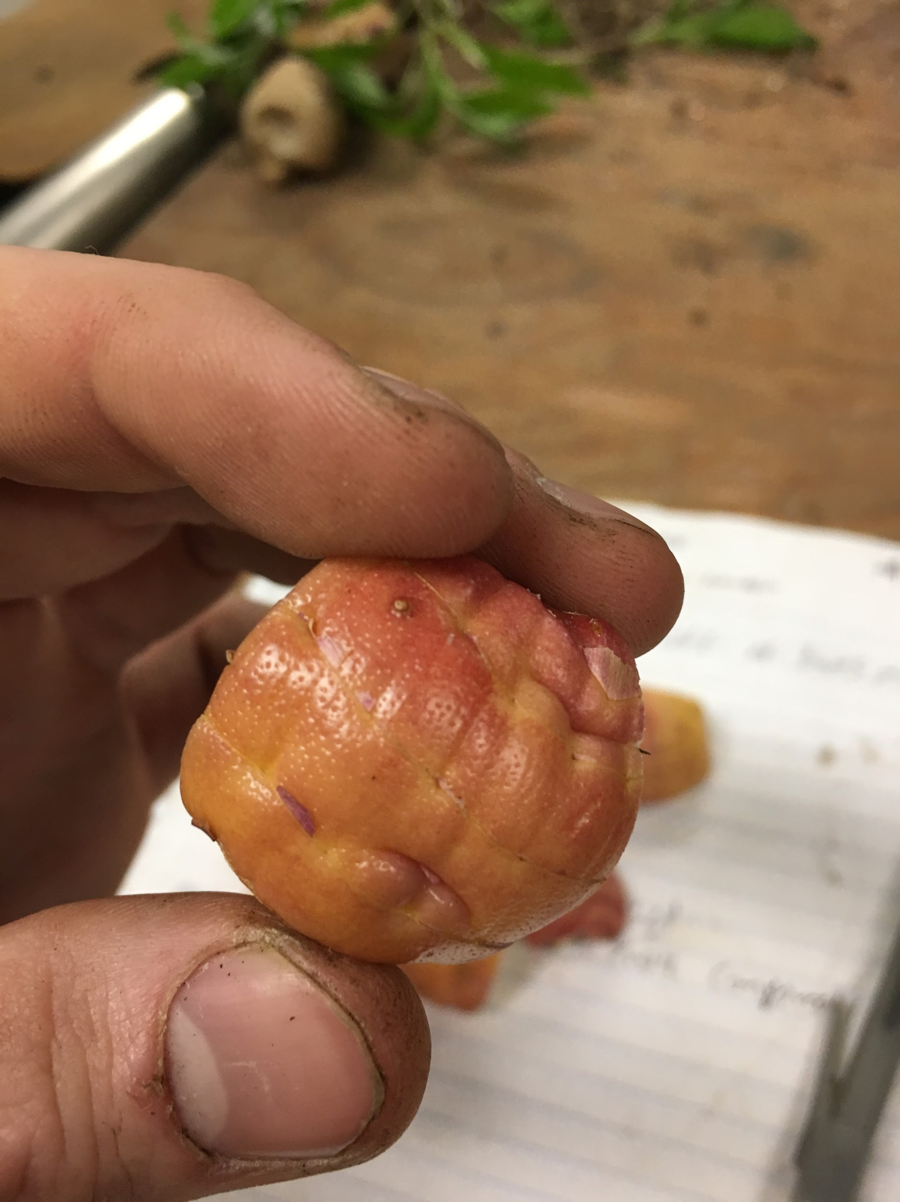
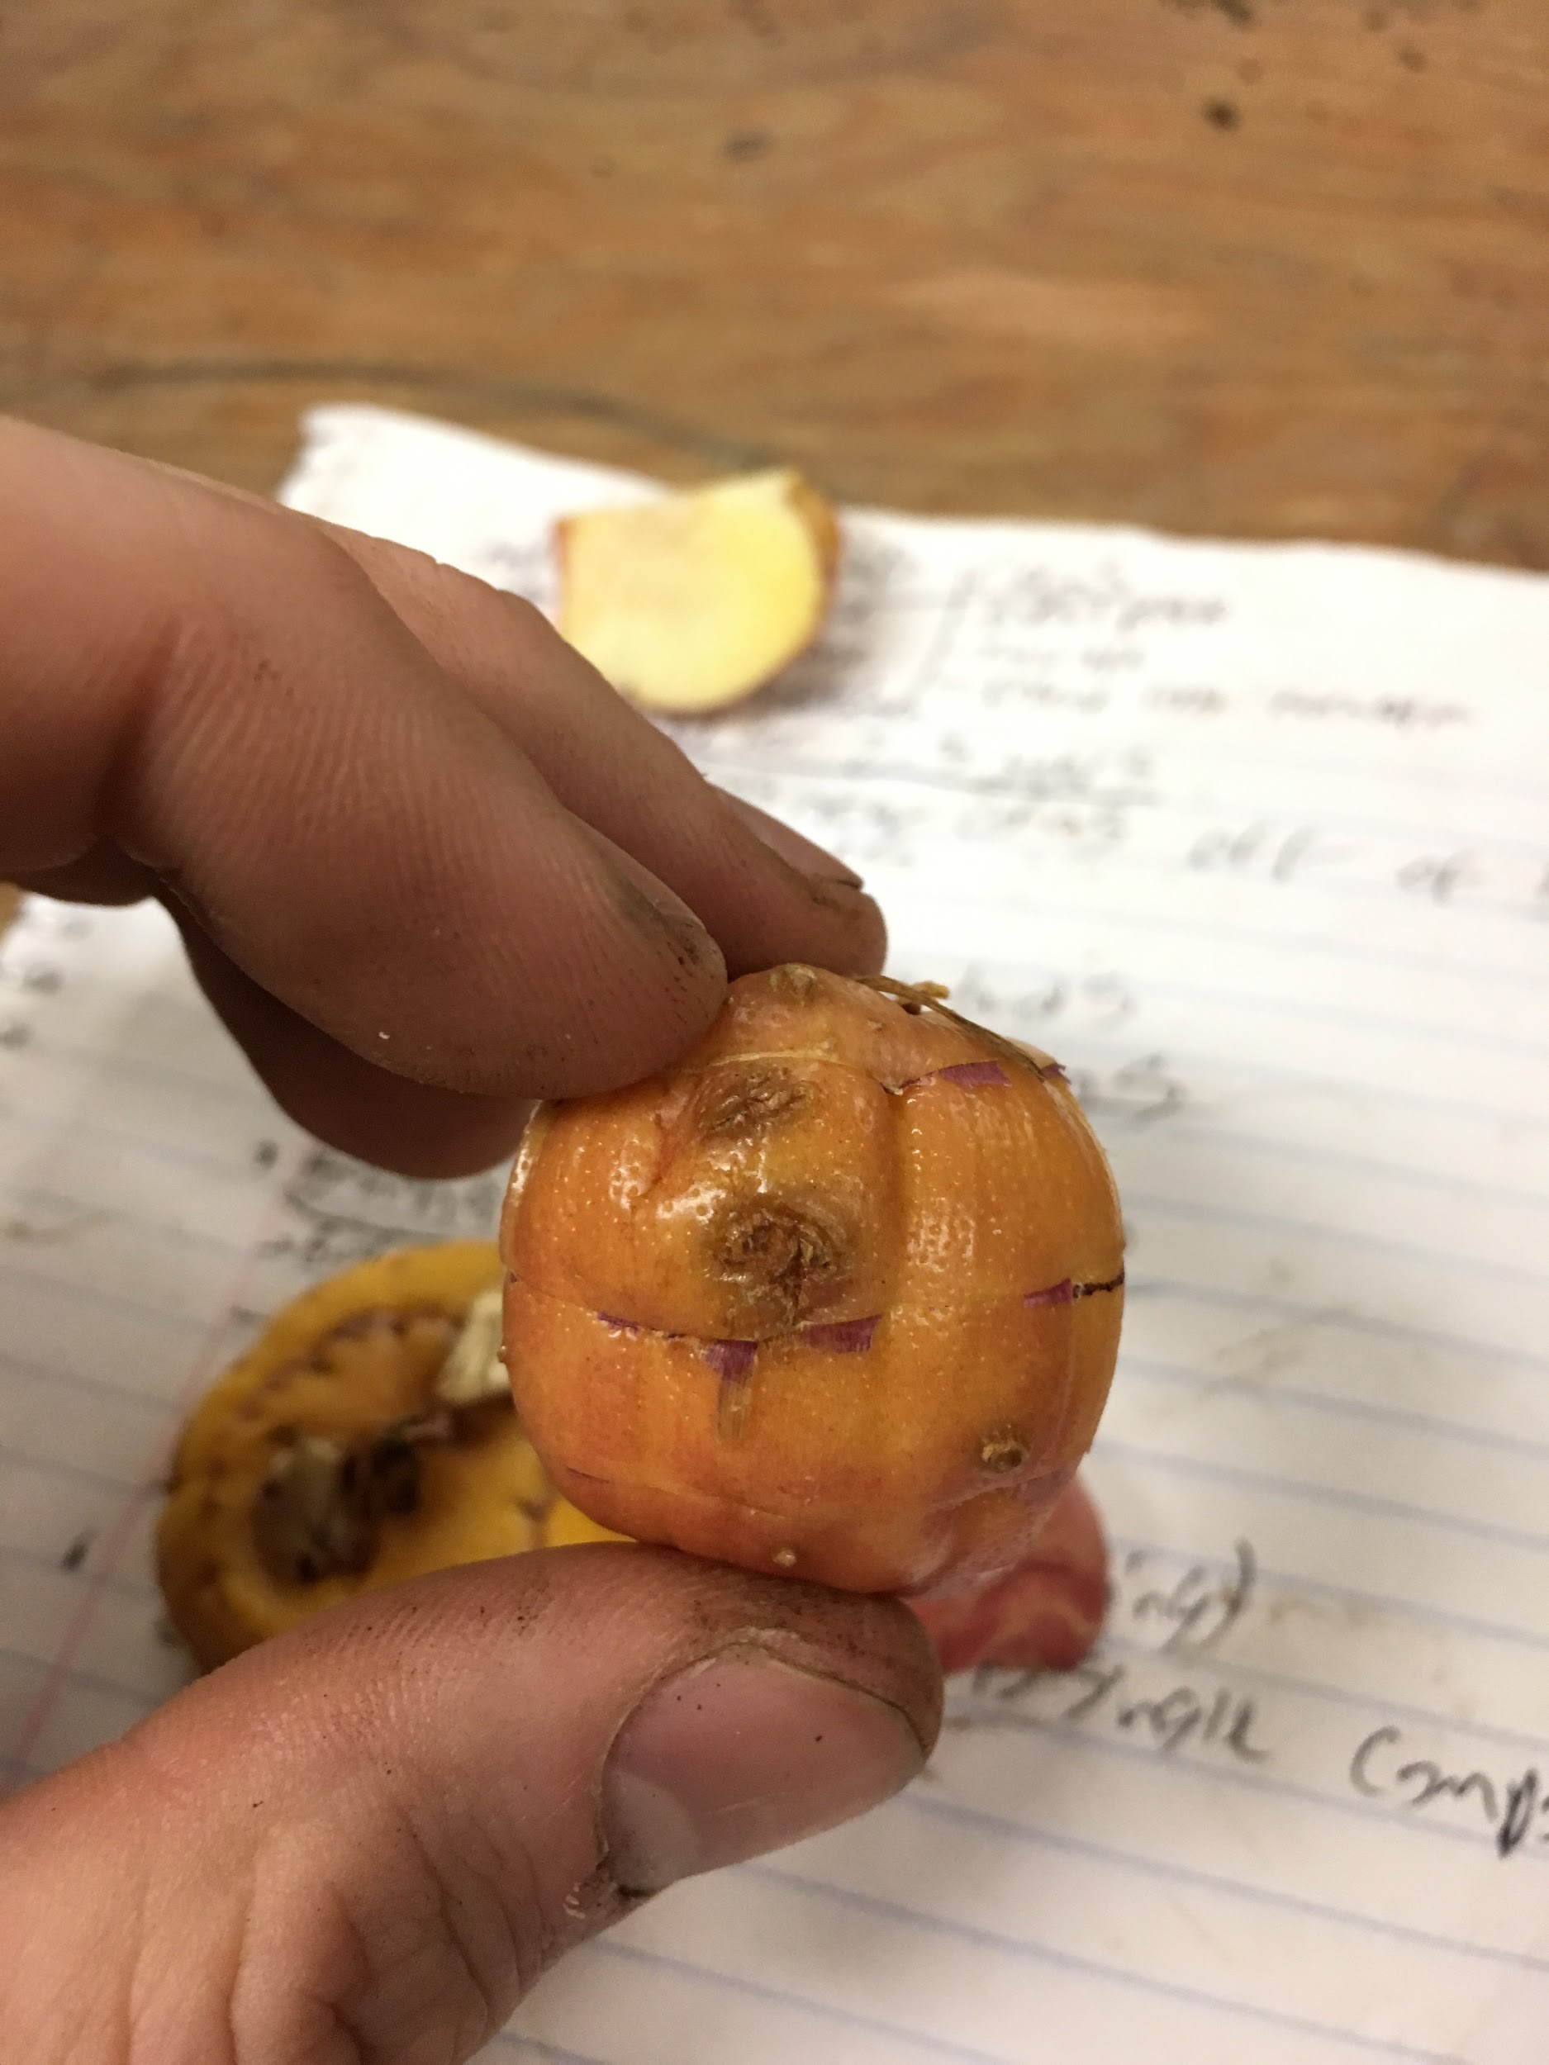

Slide 15
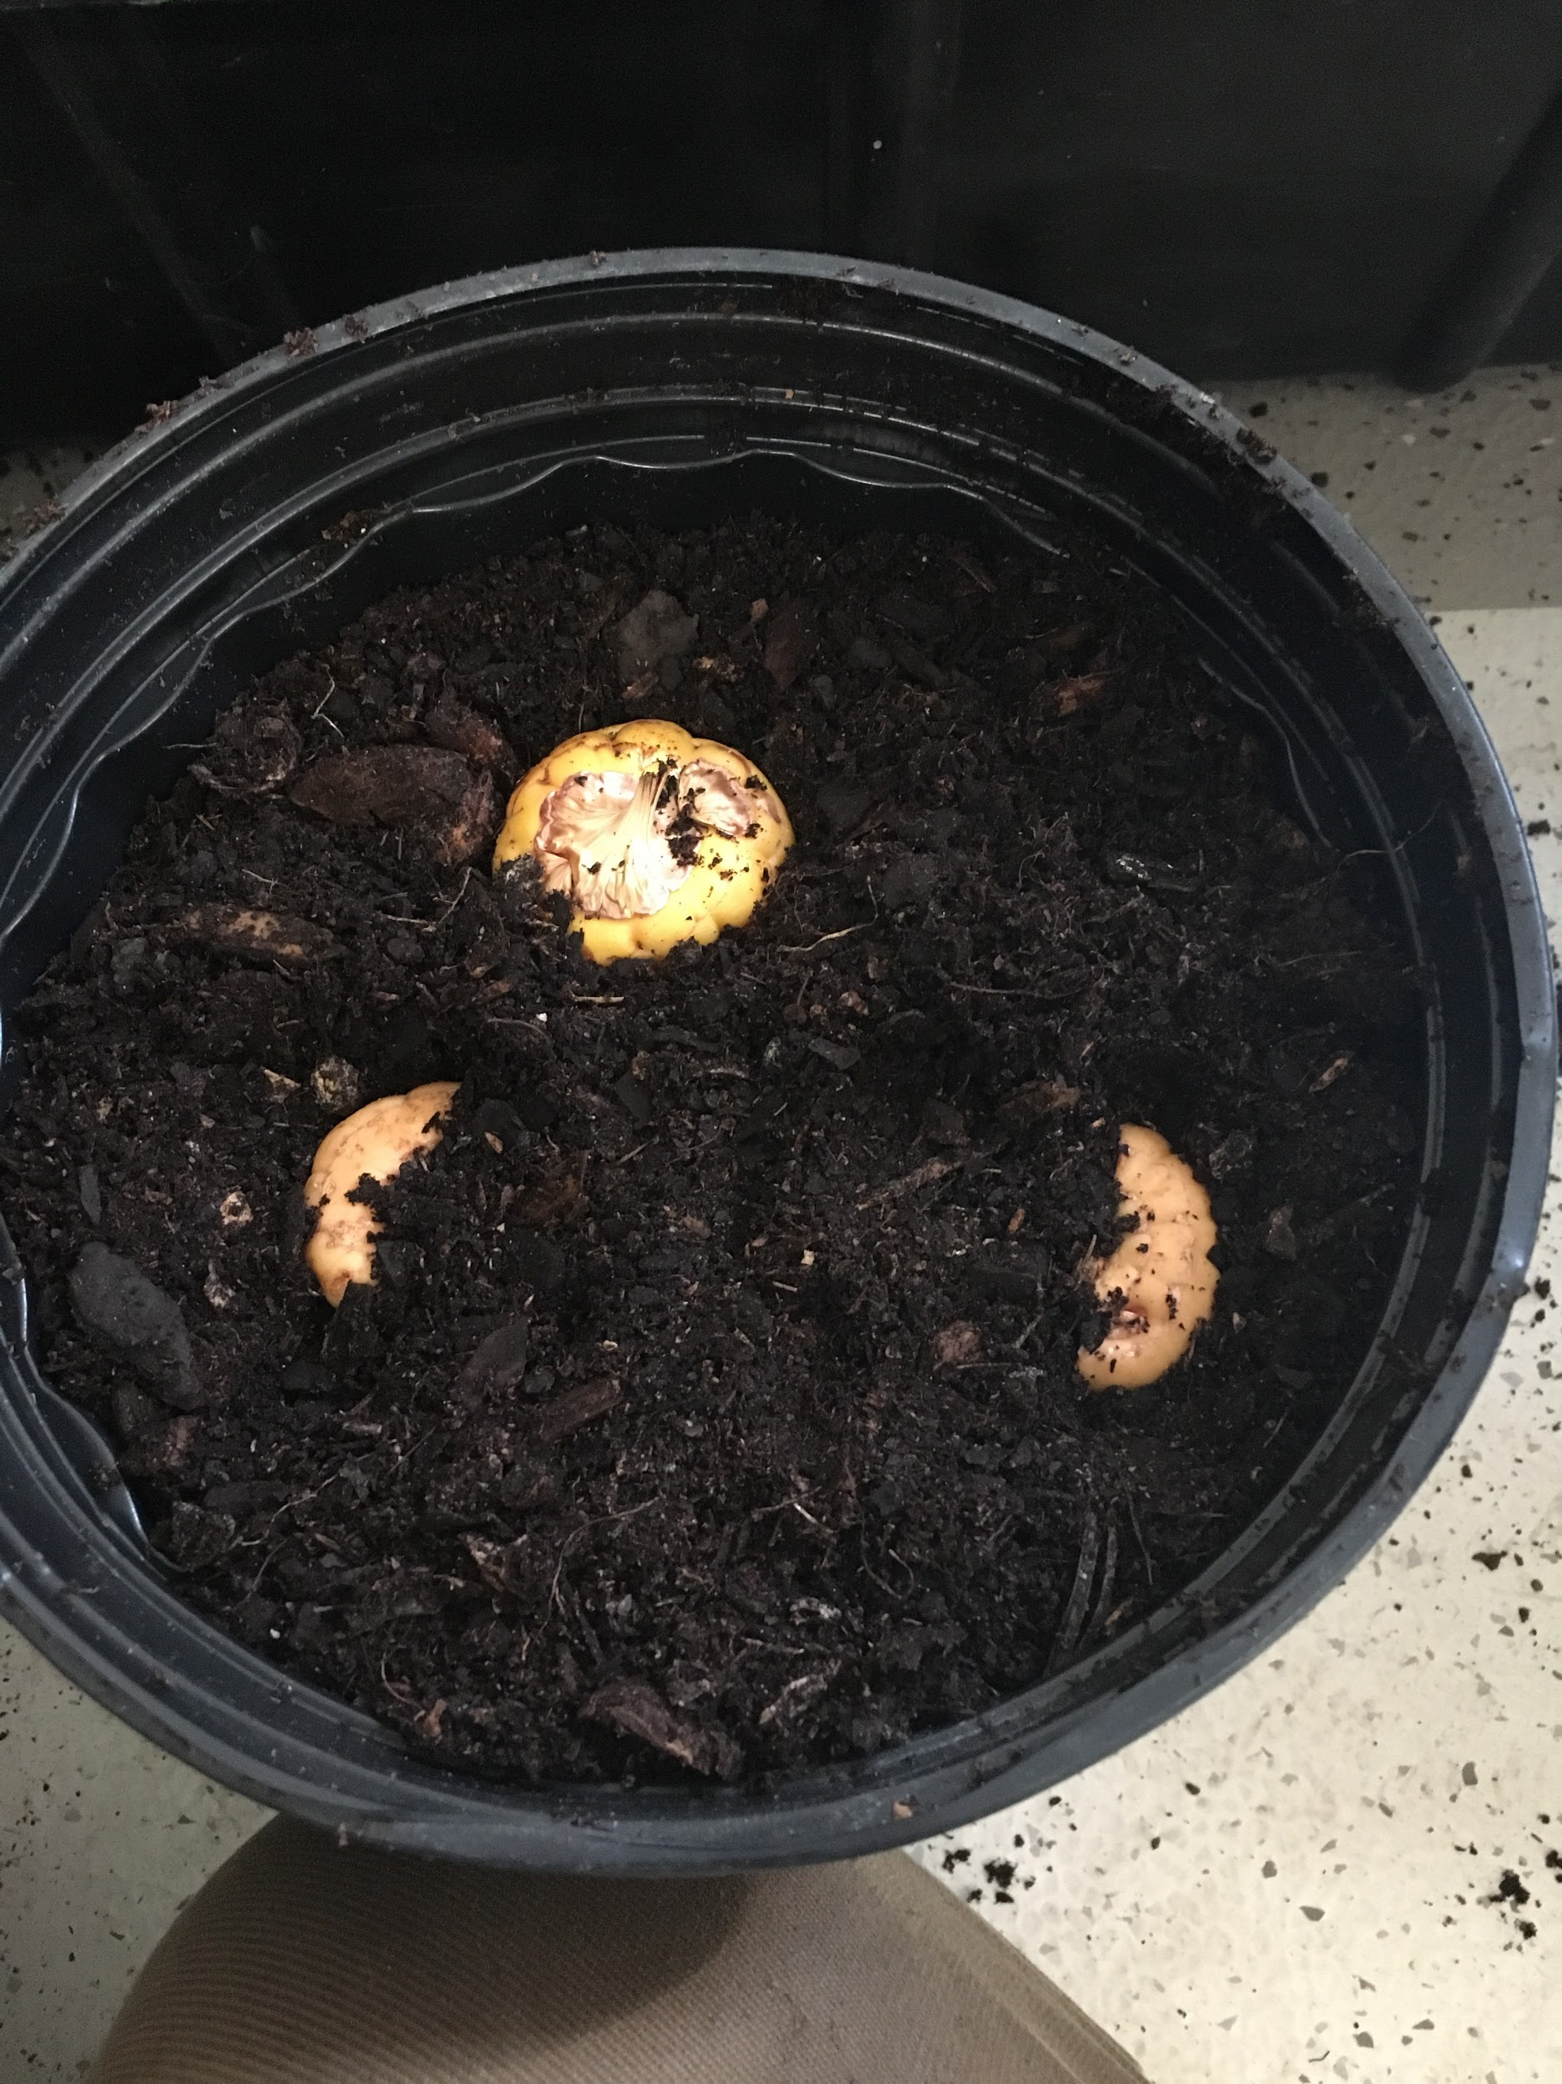
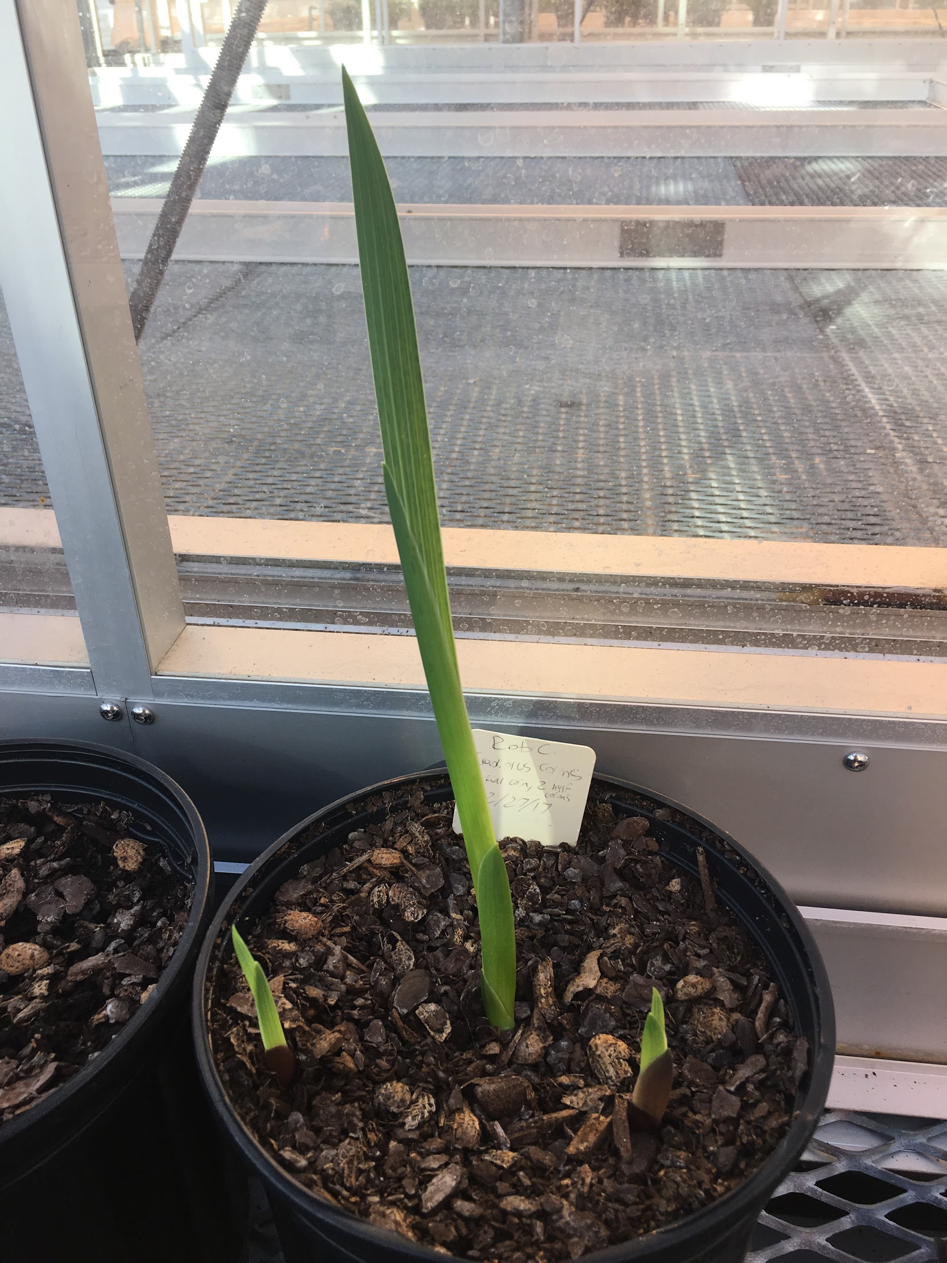

Slide 16
Rhizomes: Ginger Root and Canna
Underground lateral stems with nodes and internodes
Primary stem for plants, grows horizontally underground, and nodes give rise to new shoots
Two types: Pachymorphic (clumping) and leptomorphic (running)
Propagation by division: node cuttings
Usually prolific growth habit

Slide 17
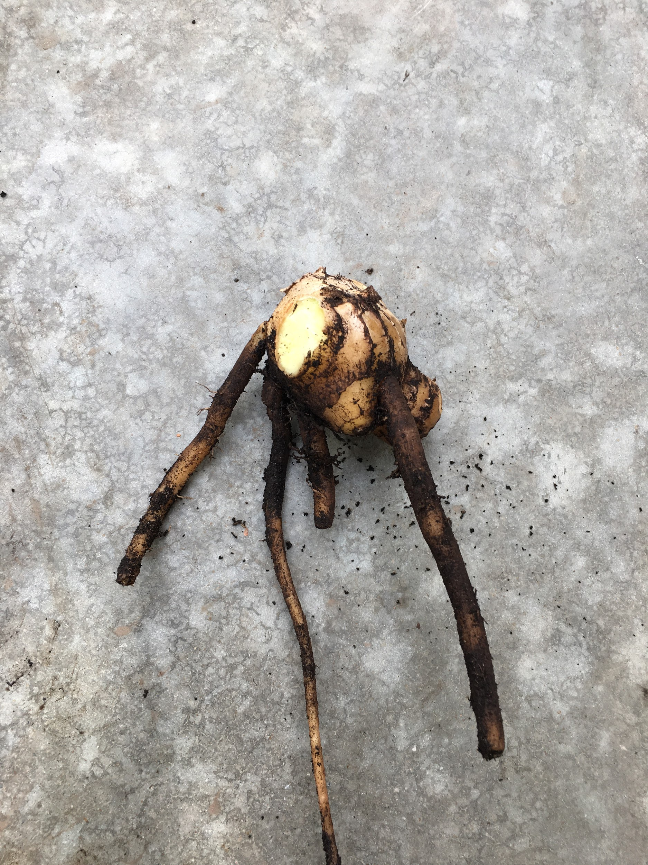
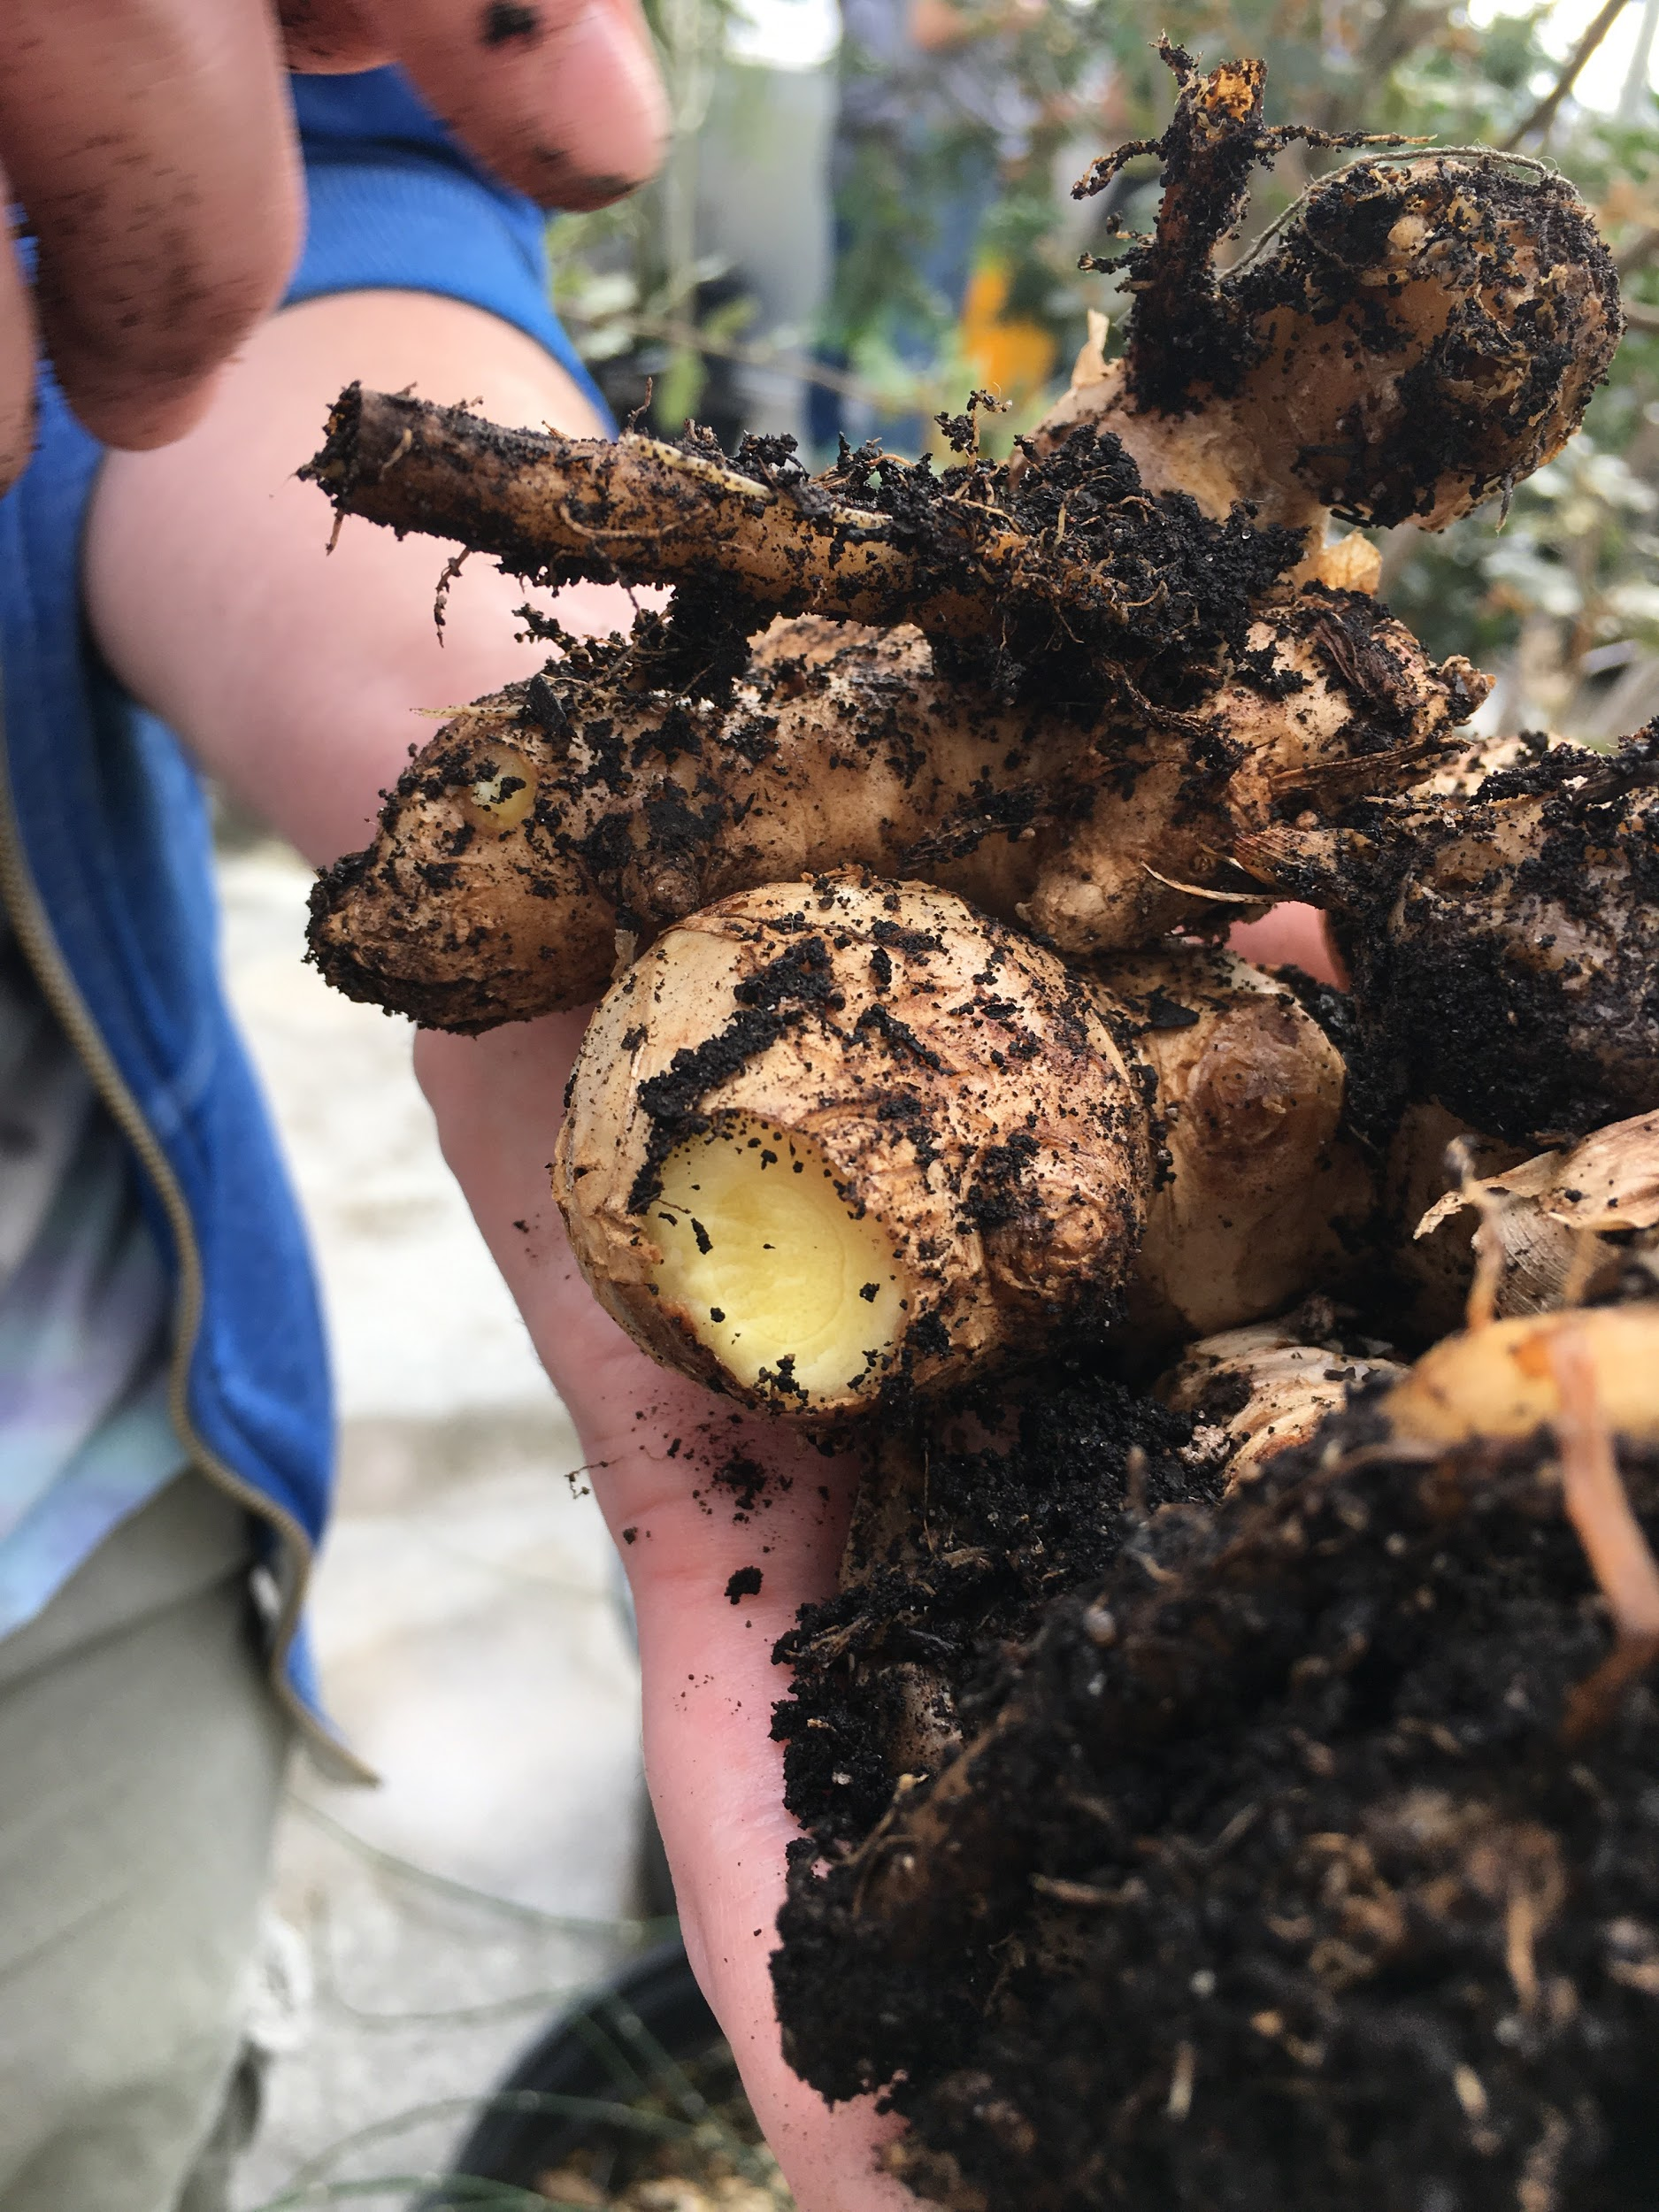

Slide 18
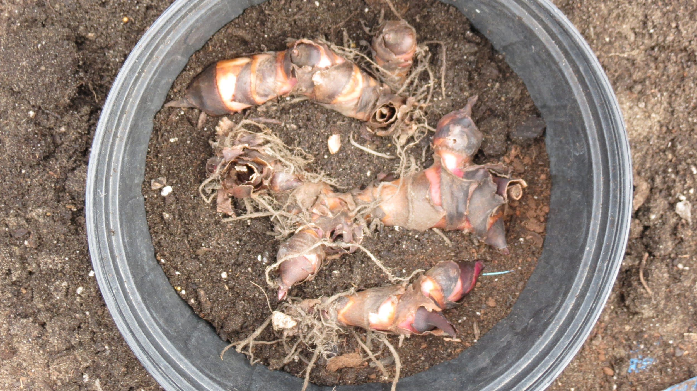
https://nittygrittydirtman.files.wordpress.com/2012/04/img_0771.jpg

Slide 19
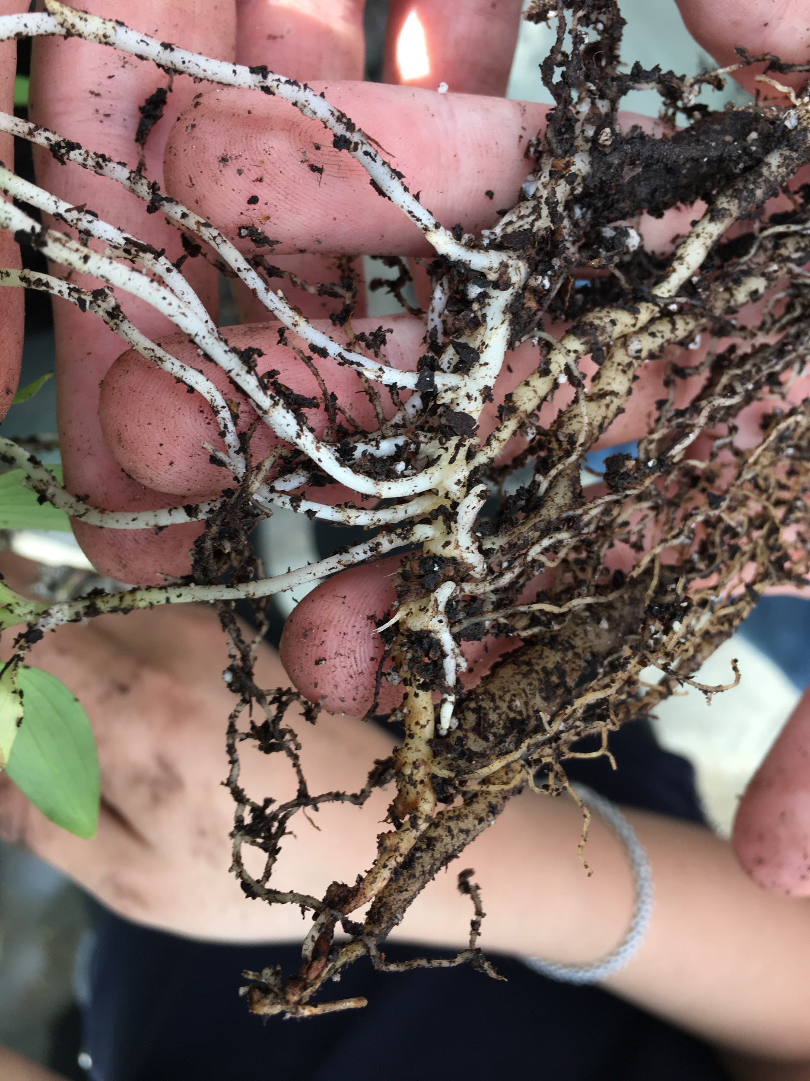
Notes:
Ginger rhizome

Slide 20
Stem tubers: Potato
Swollen underground stems with nodes and internodes
  Internal pith, cortex, and vascular tissue
Do not form roots directly (stem)
Propagation by stem cutting
  Make sure buds are present!
Or division
  Include roots as well

Slide 21
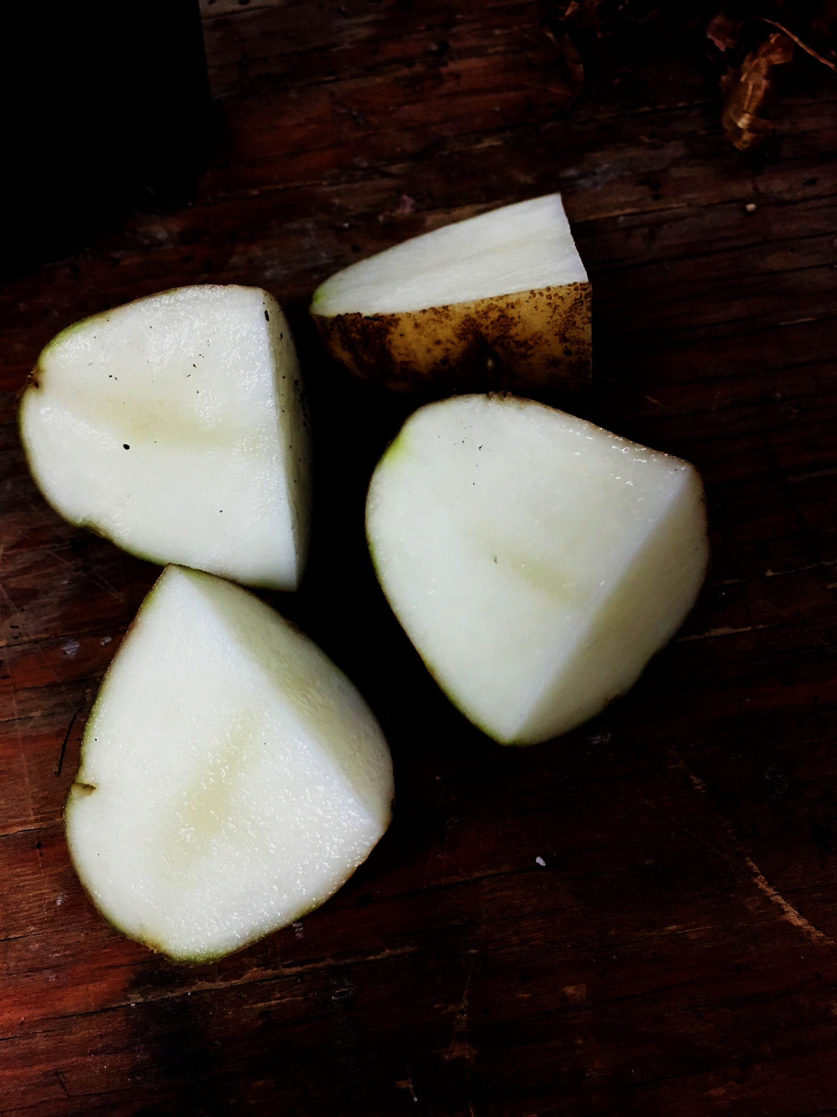
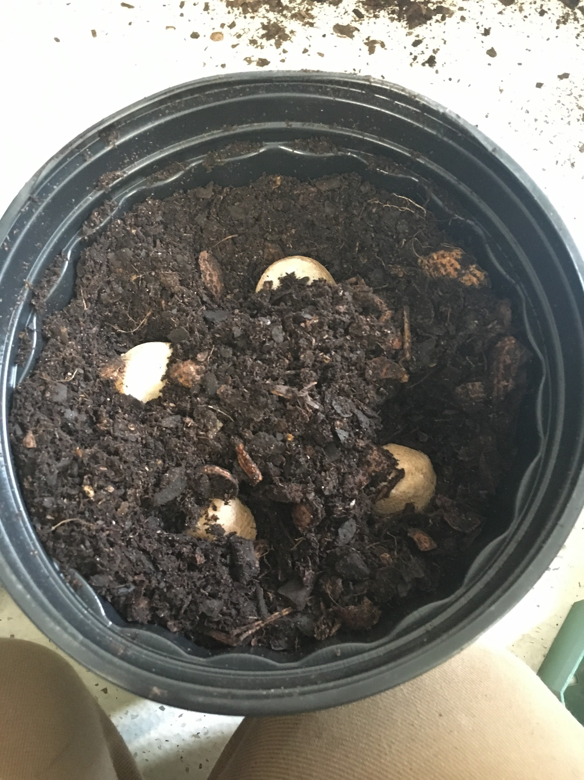

Slide 22
Fleshy Tuberous Roots: Dahlia
Secondary roots and swollen stems
  Originate from hypocotyl or epicotyl
Lack buds, and form roots directly
Propagation by division

Slide 23
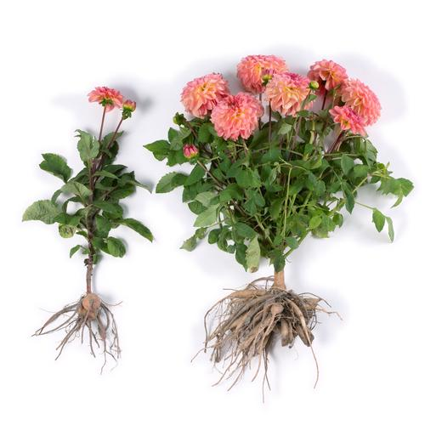
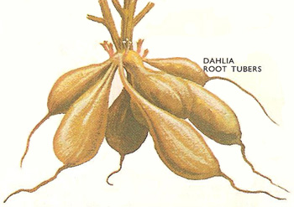
https://www.longfield-gardens.com/_ccLib/image/articles/ADDI1-13.jpg
http://www.daviddarling.info/images2/dahlia_root_tubers.jpg

Slide 24
Where To Go For More Info on Geophyte Propagation
Tons of casual and professional propagation resources!
Bulb: https://www.rhs.org.uk/advice/profile?PID=101, https://www.gardeningknowhow.com/ornamental/bulbs/bgen/propagate-flower-bulbs.htm
Corm: http://plantpropagation.com/corms.htm
Rhizome: http://plantpropagation.com/rhizomes.htm
Tubers:https://www.google.com/url?sa=t&rct=j&q=&esrc=s&source=web&cd=13&ved=0ahUKEwiF1aX64L7TAhUD6iYKHS4FCZQQFghXMAw&url=http%3A%2F%2Fwww.botanical-online.com%2Fenglish%2Ftuber_types.htm&usg=AFQjCNFADXuxSnXB1rVSqqiV9eVN67m_6A&sig2=4KaUwmEYQhTYHLZlLhhK5g&cad=rja
Tuberous roots/ stems: https://www.britannica.com/science/tuberous-root, https://www.google.com/url?sa=t&rct=j&q=&esrc=s&source=web&cd=14&ved=0ahUKEwimzYys4b7TAhWB5SYKHVWMDncQFghnMA0&url=http%3A%2F%2Fwww.whs.wwusd.org%2Fpage%2F3465%2FdownloadFile%2F39999&usg=AFQjCNGQVhKFPnGMeuKziJ7P9v3ArDbkJA&sig2=fE_nzxmuLuAlwNWApydCjg&cad=rja
General Geophytes: http://aggie-horticulture.tamu.edu/galveston/weekly_Q&A/f&b-13-propagation-bulbs.htm, https://garden.org/courseweb/course2/week4/page6.htm

Slide 25
Resources Continued
Additionally, general propagation resources include Plant Propagation: Principles and Practices by Hartmann and Kester, as well as the American Horticultural Society, HortTech/Science, Annals of Botany, Journal of Experimental Botany, and as always, Google Scholar/Google

