Slide 1
Seedling and Clonal Life Cycles
By Tiffany Reese and Henry Schmidt

Slide 2
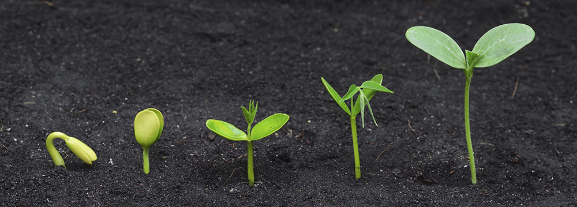
What is a seedling?
Any plant originating from seed, despite current life stage
Seeds are produced by sexual reproduction
  Flower is pollinated
  Petals drops and ovary swells with developing seed
  The seed or seeds mature, are released, then germinate
  All germinated seeds are part of the same seedling population
https://tinyurl.com/kuww8qb

Slide 3
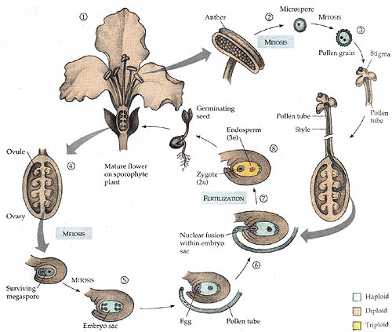
Seedling Life Cycle
https://tinyurl.com/m26wsra

Slide 4
Life Cycles
Annual - complete seed germination to seed dissemination and death in one growing season
  Agricultural plants
Biennial - two growing seasons to complete life cycle, require dormant period to become fully mature
  Carrots, Onions
Herbaceous perennial - can produce shoots and die back several times before becoming productive depending on accumulated resources
  Ginger, Rosemary
Woody perennial - continual growth annually from above ground stems
  Trees, Vines, shrubs.

Slide 5
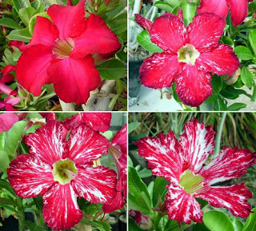
Seedling Populations & Genetic Variation
A seedling population is any group of seedlings that originate from the same pollination event and share the same parental source
High variability in seedling populations
Allows for the display/emergence of novel traits that may be desired for cultivation
https://tinyurl.com/lwxn5dy

Slide 6
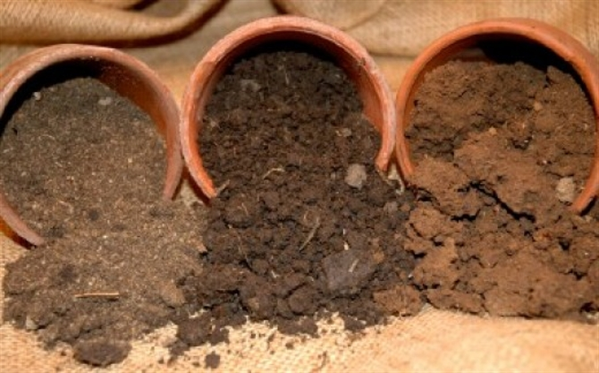
Genotypic & Phenotypic Variation
Genotype - the total genetic information that makes an individual organism, accounts for the variability among unique individuals
Phenotype - the displayed characteristics of a given genotype, influenced by environmental conditions
Some plants will look different under different environmental conditions, even if they are clones
https://tinyurl.com/lbzaabe

Slide 7
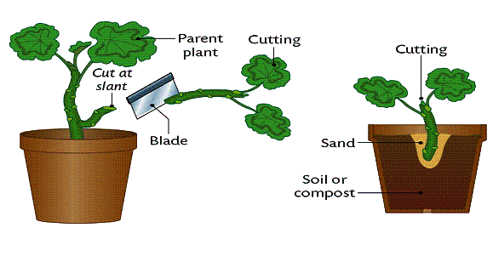
What is a clone?
A produced cell, cell component, or plant that is genetically identical to the unit it was taken from
Derived from the greek word Klon, meaning slip or twig
Selective reproduction from various methods such as budding, grafting, division, etc.
Clones are produced through asexual reproduction.
  Explant is taken from mother plant
  Cells dedifferentiate and redifferentiate if cells have the competence to develop new tissue through determination (i.e., parenchyma cells forming adventitious roots)
  Once successfully established development continues
http://tinyurl.com/l6yqsjq

Slide 8
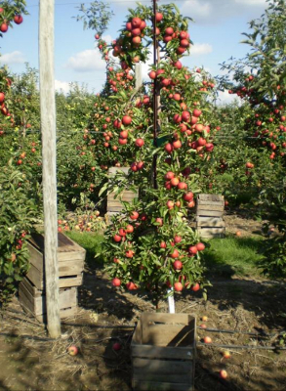
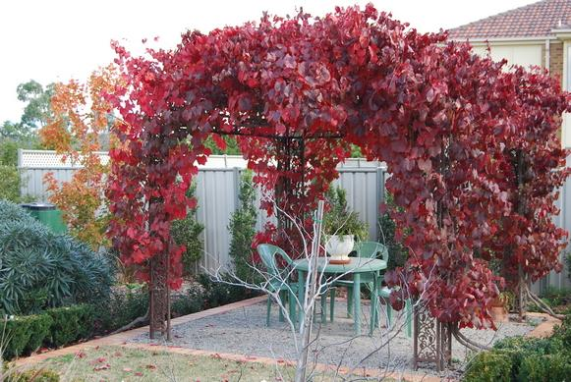
When can I clone a plant?
Depends on the characteristics of the specific plant and your needs
Juvenile or mature?
When clonally propagated, plants maintain their phase potential, or the continuation of the state in the life cycle in which they are in
Used to produce different characteristics
  Easier to propagate clonally when juvenile
  Juvenile plants display certain characteristics such as rapid growth, large leaves, thorniness, lack of flowers, etc.
Plant dependent
  Difference in propagating trees for fruit & ornamental plants for aesthetic purposes.
http://tinyurl.com/k66occf
http://tinyurl.com/k859cjm

Slide 9
Seedling (sexual)
Clonal (asexual)
-Genetic variation
-Less expensive
-Disease resistance coupled with variation
-Germination difficulties, less easy to manage
-Lack of genetic variation
-Purchasing transplants can be expensive
- Requires more effort and care
-Not possible with certain species
-Many specific methods of propagation.

Slide 10
Propagation Situations
1: You stumble upon a unique and beautiful plant that you wish to reproduce to explore its phenotypic variation potential - should you come back and collect seed or grow this by cutting
2: You want to grow plants across a large area of land, what is the most effective way to do this?
3: You want to grow a specific fruiting tree that you found, what are the advantages and disadvantages of this growing this from seed or by clonal reproduction?
4: You have purchased a pepper at a local farmer’s market that you find to have a particularly great color and flavor. What considerations should you make if you desired to propagate this plant? What are some possible ways that you might establish these peppers in a garden?

Slide 11
Helpful Resources
Hartmann & Kester’s Plant Propagation Principles and Practices
Terry Ettinger
Powerpoint on the Biology of Plant Propagation:
http://dept.ca.uky.edu/PLS440/lectures/lifecycles.pdf
Biology of Plants (Raven)

Slide 12
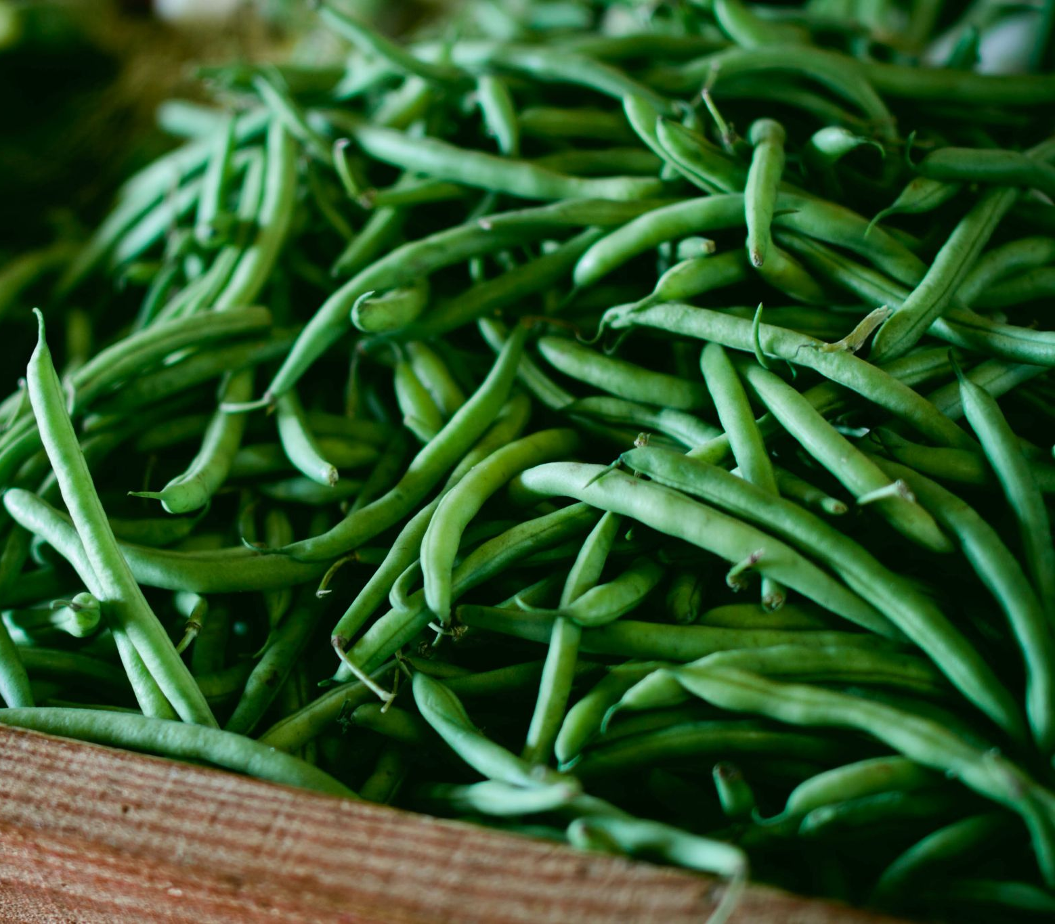
References:
http://lifeofplant.blogspot.com/2011/05/cloning-of-plants.html
Hartmann, Hudson T., PhD, Dale E. Kester, PhD, Fred T. Davies, PhD, and Robert L. Geneve, PhD. Hartmann & Kester's Plant Propagation Pricliples and practices. Saddle River: Prentice Hall, 2011. Print.

Slide 13
Questions?

