Slide 1
SEEDS
Shelby Farnham and Jacob Schreiner

Slide 2
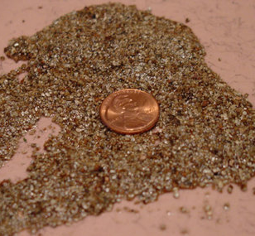
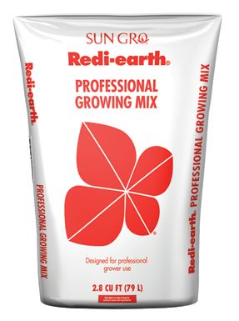
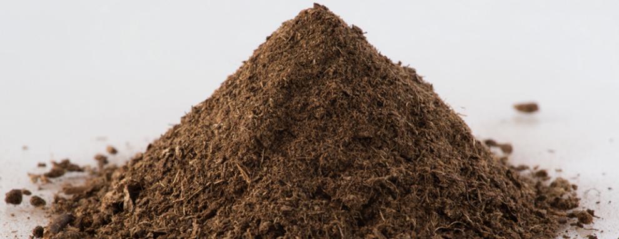
Media
Notes:
Use Redi Earth and a fine vermiculite
Holds water
Light
Good drainage

Slide 3
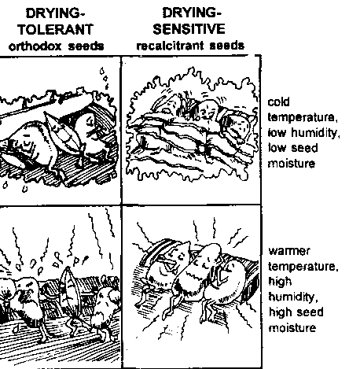
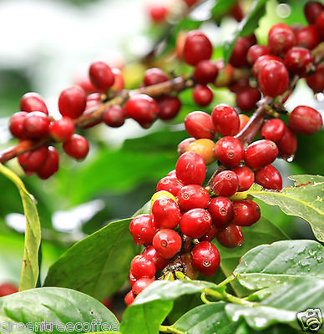
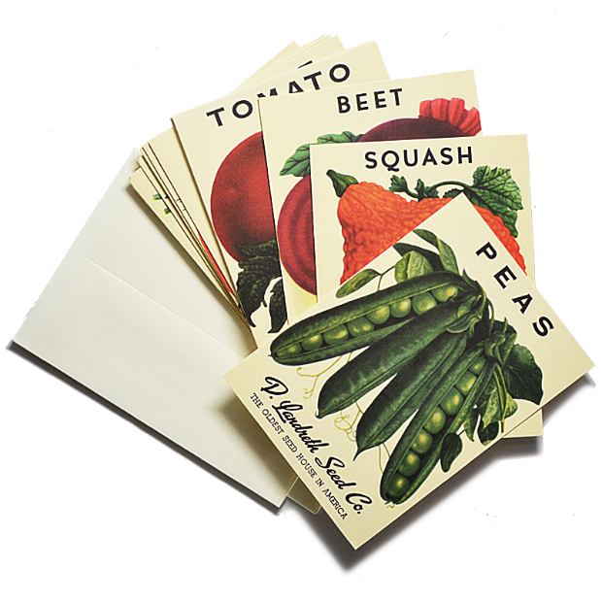
Recalcitrant vs. Orthodox
Recalcitrant
  Seeds that are unable to withstand maturation drying.
Orthodox
  Seeds that tolerate maturation drying and survive at less than 10 percent moisture
Notes:
Recalcitrant- planting must be done shortly after maturity of the seeds are reached or stored under very specific conditions ie high humidity that prevents drying such as coffee which can be stored up to 10 months or coconut which can be stored for 16 months or the oak for 20 months.

Slide 4
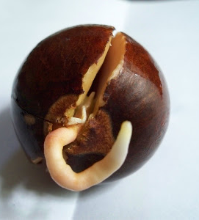
Germination
Priming
  to prime seeds keep them in a warm humid environment where they can be easily observed.
  Once the radical emerges they should be immediately planted.
PreGermination
  A technique for bedding plants that uses a special process to synchronize radical emergence and then slowly dry seeds prior to sowing.
  Under the right conditions, this treatment ensures near 100% germination
Viability Determination
  Rolled Towel Test
    Large seeds
Notes:
Priming-to prime seeds keep them in a warm humid environment where they can be easily observed. Once the radical emerges they should be immediately planted.
PreGermination- a technique for bedding plants that uses a special process to synchronize radical emergence and then slowly dry seeds prior to sowing. Under the right conditions, this treatment ensures near 100% germination.’
Rolled Towel Test- used for large seeds such as cereal grains but we see it here with the lemon seeds.
several layers of moist paper towel-folded over and rolled- could be placed in a plastic bag in a warm place
Check after 1st week and see what types of seeds you have
normal-elongated radical and hypocotyl and one enlarged cotyledon
hard seeds
abnormal
decaying ect.

Slide 5
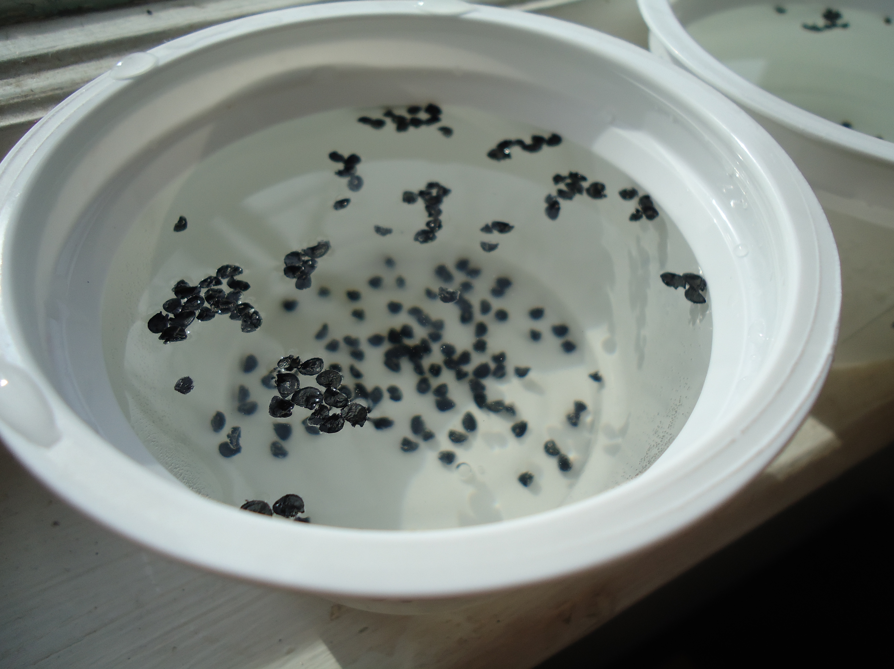
Priming Seeds
Onion Seeds soaking in water
Notes:
seed priming
shortens germination time but doesn't allow for complete germination
often done by imbibing seeds for a predetermined period of time depending on what type of seed you are planting.
seeds can be primed then dried out to be sown later.
types
hydro priming
soak seeds in water
osmotic
soaking seeds in a solution of KNO3, KCl, or NaCl
solid matrix
priming seeds in a wet insoluble substance such as vermiculite
allows for slow imitation
drum printing
seeds are placed in a rotating drum with a controlled level of water vapor release

Slide 6
Exogenous Dormancy
Conditions outside the embryo
Physical Dormancy
  Caused by the impermeability of the seed coat
  Develops during the maturation of the seed i.e. seed drying
  Once physical dormancy is broken it cannot be reinstated or reentered
Mechanical Dormancy
  The seed coat (other coverings) prevents the embryo from expanding
Chemical Dormancy
  Growth regulators in the covering around the embryo prevents growth.
  When the seeds are soaked this can leech the growth regulators and break the dormancy
Notes:
exogenous dormancy
conditions outside the embryo
physical dormancy
caused by the impermeability of the seed coat. develops during during the maturation or the seed i.e. drying. once broken cannot be reinstated
mechanical
the seed coat and other covering prevent the embryo from expanding.
chemical
growth regulators in the covering around the embryo that prevent growth. can be leeched out by soaking
endogenous
caused by the embryo
physiological
caused by growth regulators in the embryo itself. broken when these chemicals break down, often by cold stratification, exposure to sun light or by drying
morphological
caused by the embryo being underdeveloped. this is broken by letting the seeds take up water and giving them time to finish development
secondary dormancy
some seeds can return to dormancy should them be exposed to unfavorable condition after breaking dormancy

Slide 7
Endogenous Dormancy
Conditions within the embryo prevent germination
Physiological Dormancy
  Conditions controlled by factors within the embryo must change before the seed can germinate
Morphological Dormancy
  When the embryo is underdeveloped or less than one-quarter of the size of the seed when it is shed from the plant.
  Can be broken by letting the seeds take up water and giving them time to finish development

Slide 8
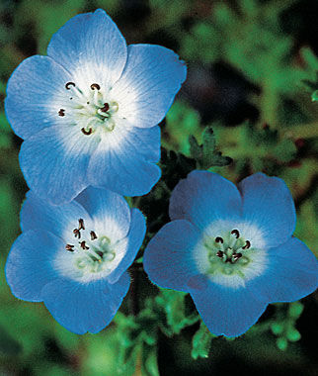
Secondary Dormancy
The seeds may return to dormancy if they fail to germinate after primary dormancy is broken due to unfavorable conditions
Example is Baby blue eyes (Nemophila) seeds require darkness or no light to germinate if exposed to light they need to go through a chilling or exposure to cold to germinate. Burpee suggests direct sowing when night temperatures are no higher than 65 degrees Farenhiet

Slide 9
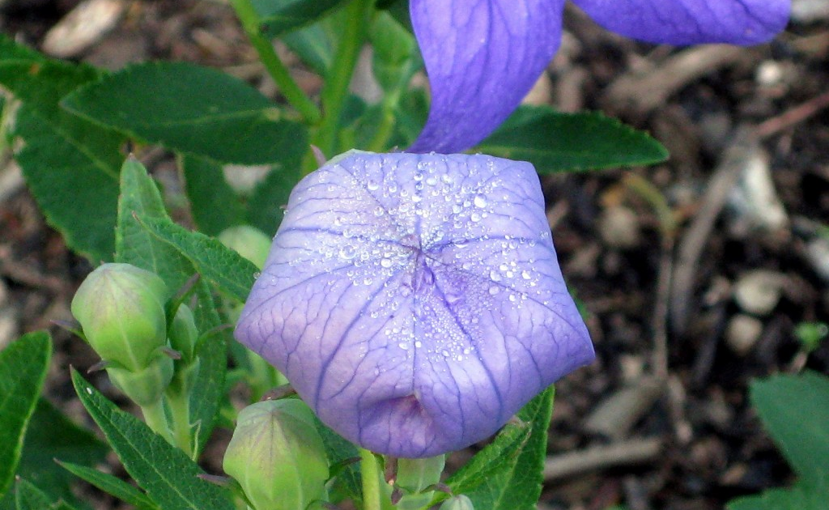
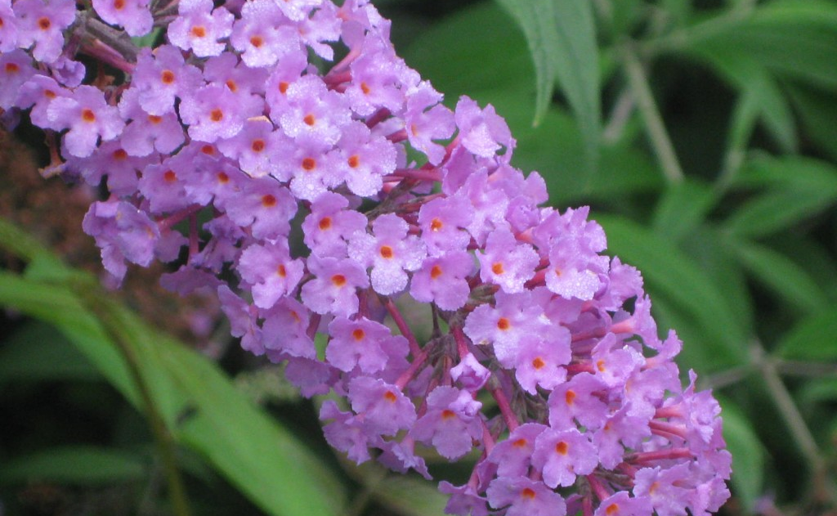
Cold Stratification
Used to mimic the passing of winter
Some temperate perennials require this to overcome dormancy
Such as the Balloon Flower and Butterfly Bush
Notes:
http://www.agardenforthehouse.com/2013/02/perennials-which-require-cold-stratification/
Aconitum (Monkshood), Alchemilla (Lady’s Mantle), Alstroemeria (Peruvian Lily), Asclepias (Milkweed), Astrantia (Masterwort), Baptisia (False Indigo), Buddlejah (Butterfly Bush, pictured above), Caltha (Marsh Marigold), Caryopteris (Bluebeard), Chelone (Turtlehead), Cimicifuga (Bugbane), Clematis, Delphinium, Dodecatheon (Shooting Star), Eremurus (Foxtail Lily), Filipendula (Meadowsweet), Fuchsia, Gentiana (Gentian), Geranium species (Cranesbill Geranium), Goniolimon (German Statice), Helianthemum (Rock Rose), Helianthus (Perennial Sunflower), Heliopsis (False Sunflower)

Slide 10
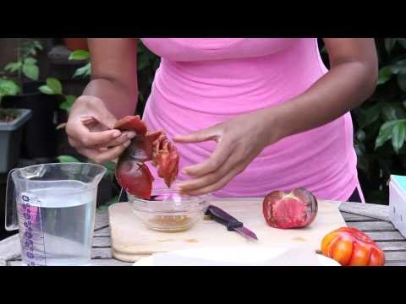
Harvesting and Storing Seeds

Slide 11
Questions?

