Slide 1
Layering
Sarah Skubel & Maria Stutzman

Slide 2
Layering
A system of vegetative clonal propagation where stems are stimulated to form adventitious roots while still attached to the parent plant
How Does it Work?
Totipotency and Etiolation!

Slide 3
Why Layering?
Maintain physical attachment to parent plant
Accumulation of carbs and hormones
Etiolation
Rejuvenation
Take advantage of rooting patterns
Notes:
This is actually more for how layering works, we should look up or think up why we should layer
Advantages: some plants just do this naturally, the “layered part” (new plant tissue) is being nutrored by the parent plant, so it has its own water and nutrients
Disadvantages: takes longer, you cant make as many new plant propagules since youre using that same parent plant

Slide 4
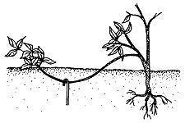
Simple Layering
Individual stems are bent over and buried
Propagule can be harvested once well rooted
Examples:
  Forsythia
  Azalea
  Rhododendron
Notes:
One year old stems layered in the spring have a well-developed root system by early autumn, and are then harvested as dormant rooted cuttings in late autumn
Current season's growth will become next year's layers

Slide 5
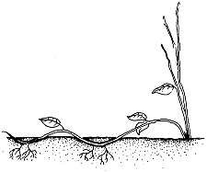
Serpentine/Compound Layering
Young stem/vines are buried
New roots and shoots emerge from nodes
Examples:
  Grape
  Devil’s Ivy
  Mint
Notes:
Utilized with (vinig) spp whereby alternating nodes on a young stem/vine are rooted, then severed to create numerous rooted cuttings
In true compound layering, the entire stem/vine is buried and resulting shoots emerging from burind nodes form roots and are then harvested.Stems below ground are etiolated resulting in formation in adventitious roots right from the base of the new shoots not tnecessarily from the original stem that was burried

Slide 6

Air Layering
Many tropical species
Steps
  Partially girdle an aerial stem
  Pack the girdled region in moist media
  Wrap the region
Adventitious roots form after several months
Examples
  Fig trees
  Rubber plants
  Roses
Notes:
n ancient technique for propagating many tropical species. At the most basic level, this technique involved the (partial) girdling of an aerial stem (usually no more than a year old), packing the girdled region in a moist media, than wrapping with waterproof material. Adventitious roots form after seveal months on the stem just above the girdled region
When you wound the stem you stop the moveent of carbohydrates
Air layering is pretty labor intensive but you create large and marketable plant right from the beginning
The opportunity to create plant in a shorter amount of time
When you wound the stem you stop the moveent of carbohydrates
Air layering is pretty labor intensive but you create large and marketable plant right from the beginning
The opportunity to create plant in a shorter amount of time
n ancient technique for propagating many tropical species. At the most basic level, this technique involved the (partial) girdling of an aerial stem (usually no more than a year old), packing the girdled region in a moist media, than wrapping with waterproof material. Adventitious roots form after seveal months on the stem just above the girdled region
When you wound the stem you stop the moveent of carbohydrates
Air layering is pretty labor intensive but you create large and marketable plant right from the beginning
The opportunity to create plant in a shorter amount of time
When you wound the stem you stop the moveent of carbohydrates
Air layering is pretty labor intensive but you create large and marketable plant right from the beginning
The opportunity to create plant in a shorter amount of time
So make a ring
And then a second ring
Onto th eunderlining wood
Bark reffered to as slipping
Squeeze out as much moisture as you can
Cover
Put into a pot

Slide 7
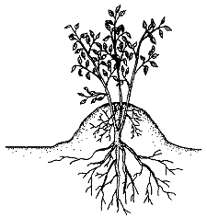
Mound/Stool Layering
Shoots are cut back close to the ground
Media is mounded over the stubs
Examples:
  Apple rootstocks
  Dogwood
  Hairystem gooseberry
Notes:
Developed in the late 1800s
One year old shoots of established plants are cut backs close to the ground, then soil or other media is mounded over the stubs. The moist, brk conditons withi the mound stimulate roots to form at the base of new shoots emerging from dormant buds of original shoots (s) that have been cut back

Slide 8
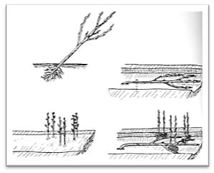
Trench Layering
Cutting planted at 45°
Trench is dug, and plant bent over and buried
New shoots emerge
New shoots harvested and plant recovered
Examples:
  Willows
  Vibernum
  Dogwood

Slide 9
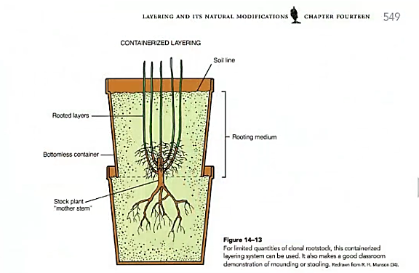
Containerized Layering

Slide 10
Additional Sources
NC State Extension - Plant Propagation by Layering
  https://content.ces.ncsu.edu/plant-propagation-by-layering-instructions-for-the-home-gardener
Garden Journey Videos
  Air Layering
    http://www.twcnews.com/archives/nys/central-ny/2010/02/16/garden-journeys---air-layering-NY_496315.old.html
  Red Twig Dogwood Unique Potting Trick
    http://www.twcnews.com/archives/nys/central-ny/2014/03/22/red-twig-dogwood-unique-potting-trick-NY_721557.old.html

