Slide 1

Budding & Grafting
Alex Fisher and Tommy Dempsey

Slide 2
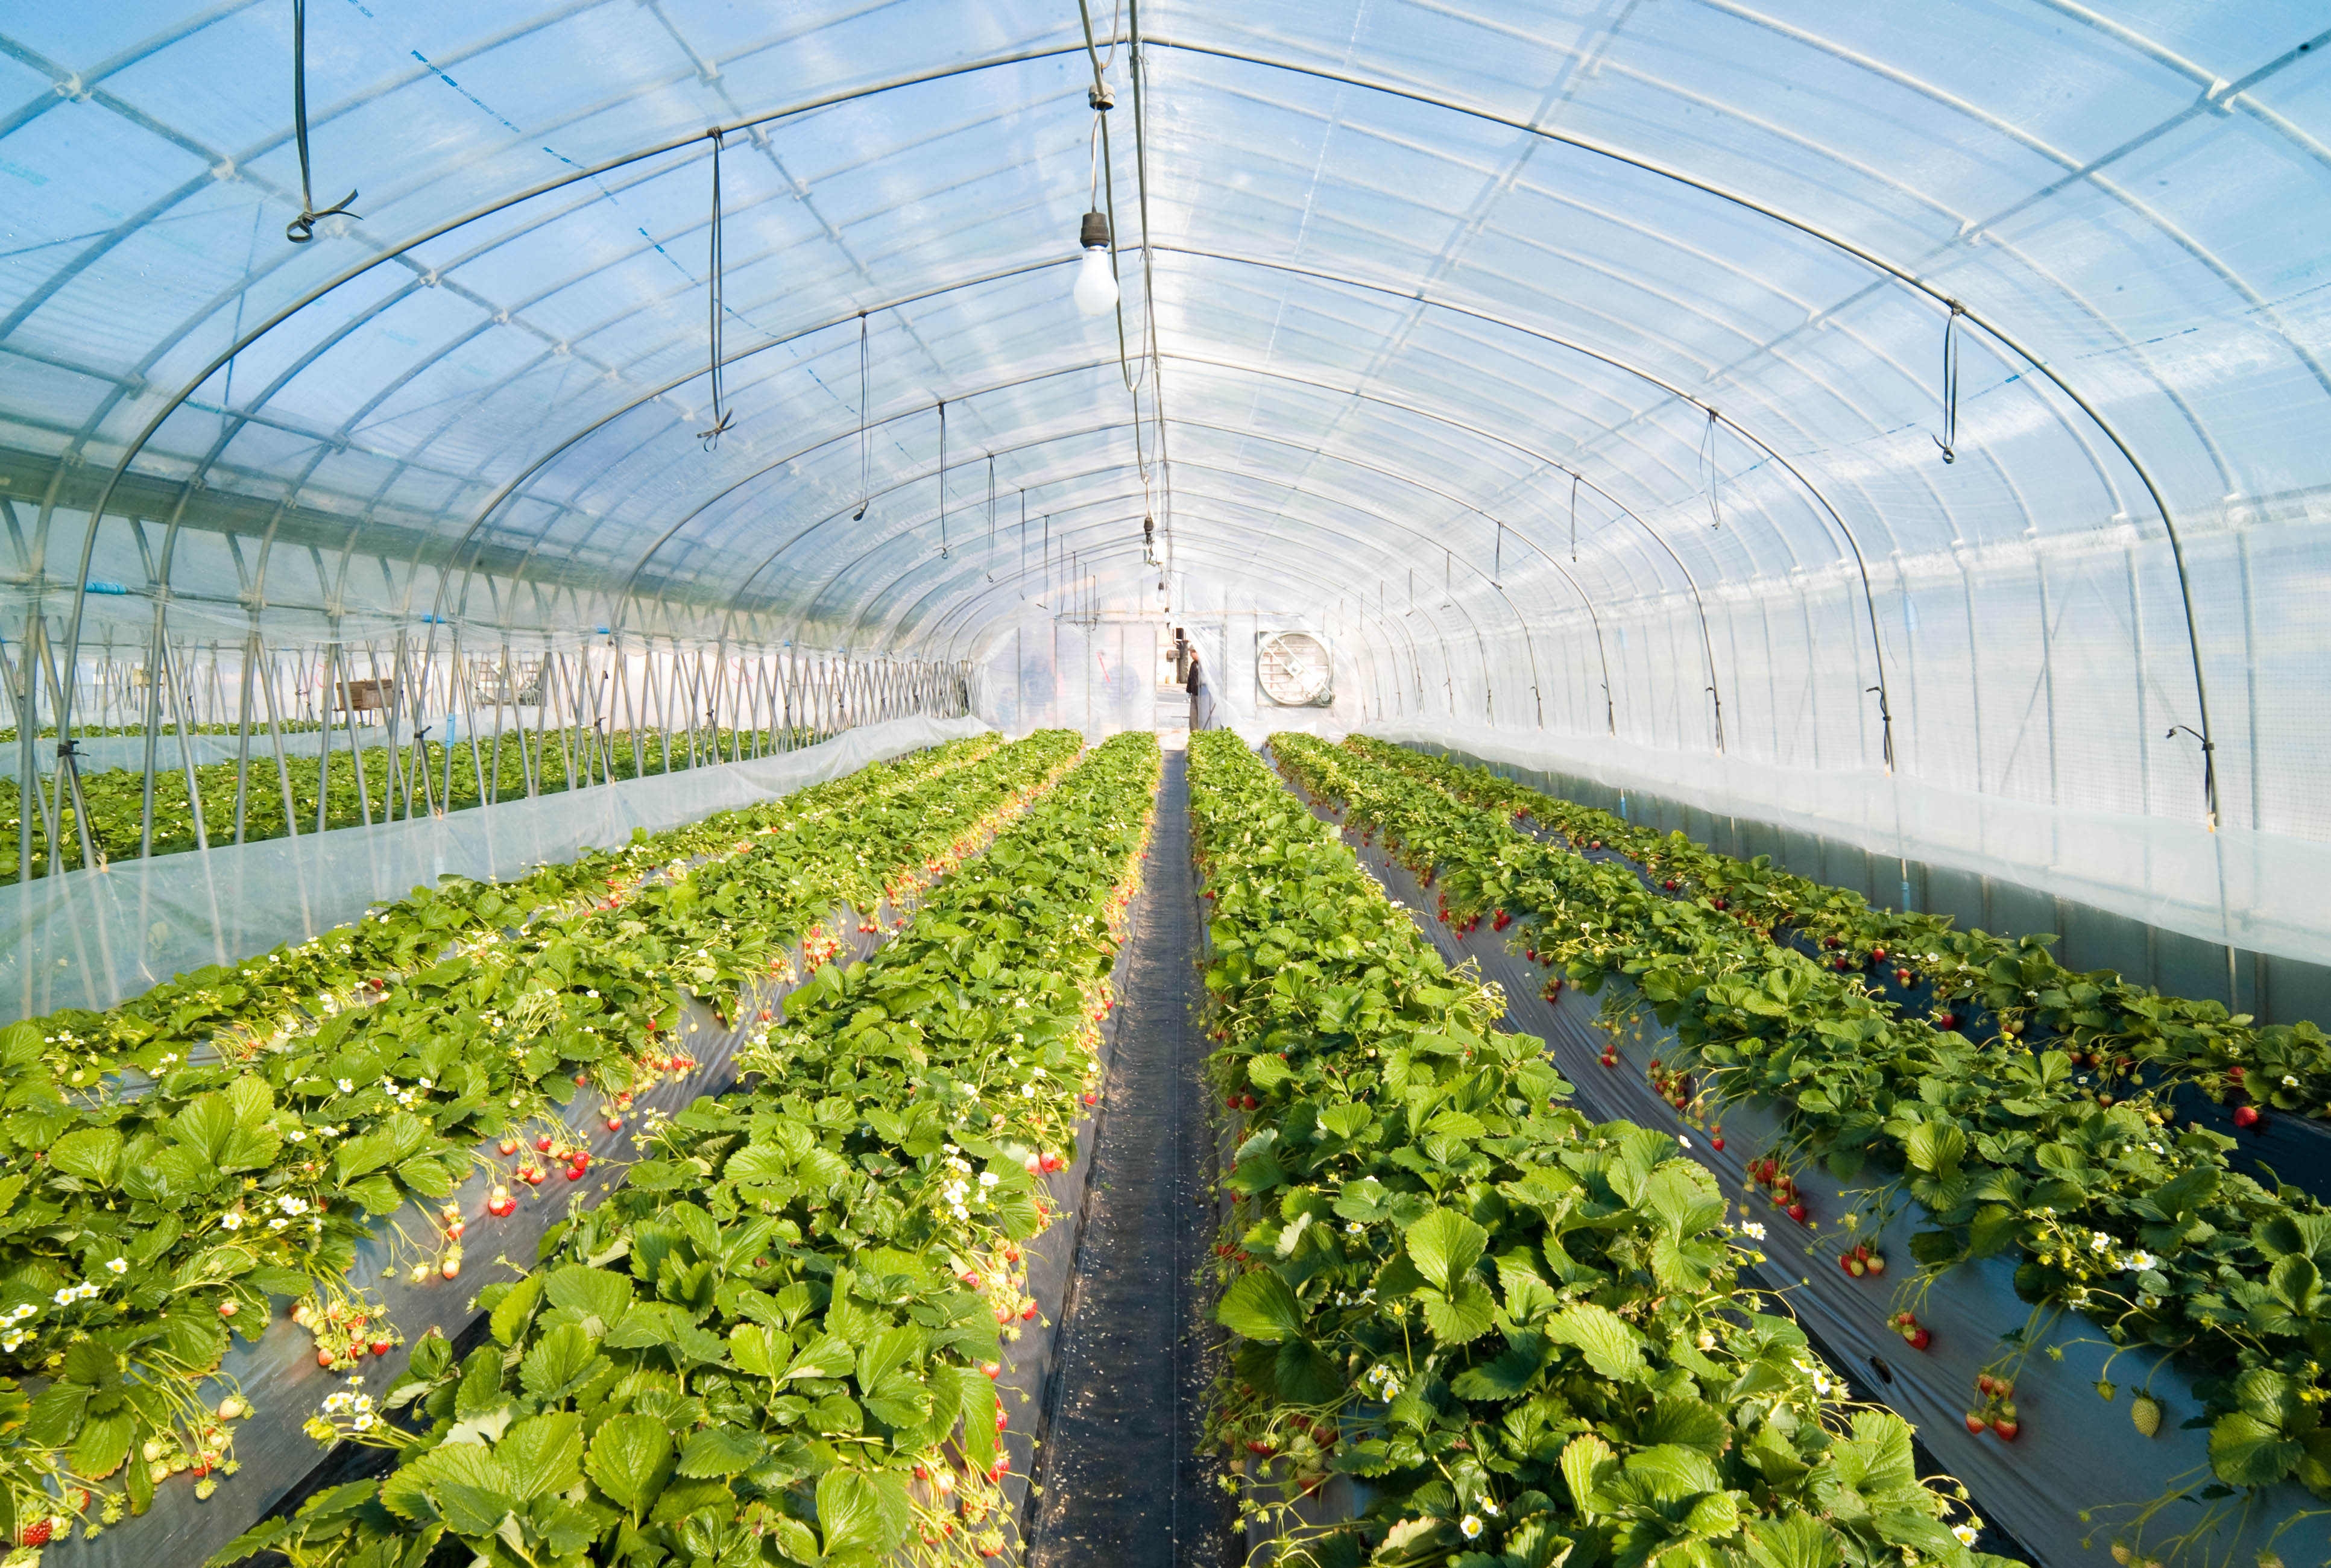
By Definition
Grafting: the union of a root system (rootstock) and a shoot system (scion) in a way that they develop into one composite (compound) plant.
Budding: a form of grafting using a smaller scion piece sometimes just a piece of the stem and an axillary bud.
Hartmann and Kester, 2011

Slide 3
Reasons for Budding and grafting
Creating clones for desired characteristics that cannot be created by other propagation methods
Combining characteristics of 2 cultivars
Using established trees roots and grafting different cultivars to it
Creating a unique ornamental that doesn't exist in nature
Repairing damage

Slide 4
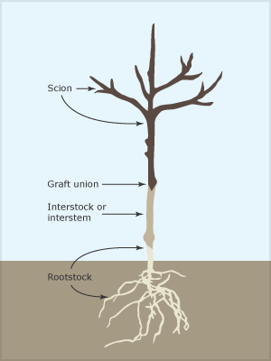
Benefits of the Different Parts of a Graft
Benefits of scions
Enhanced growth rates, fruit characteristics and yield, & plant form
Benefits of Rootstocks
Greater resistance to abiotic and biotic stresses
Controlling the size of the grafted plant
Hastened reproductive maturity (fruiting)
Hastened production time in propagation system (commercial setting)
Improved transplanting success
Benefits of Interstems
Better compatibility
Obtaining certain desired characteristics like disease resistance or cold-hardiness
Picture from http://www.teara.govt.nz/en/diagram/17253/grafted-tree
Notes:
Scion: the upper portion of the graft that will become the shoot system of the new built plant.
Interstem/Interstock: An intermediary between the scion and the rootstock that serves multiple purposes.
Graft Union: the area where the wounded portion of the scion and the rootstock are conjoined. It is where callus bridge forms and the parenchyma cells in the cambium differentiate.
Rootstock: the lower portion of the graft that becomes the root system of the new composite plant.

Slide 5
Types of Grafting
Detached Scion Graftage: type of graft where a section of the shoot of the scion is removed and grafted to the apex or side of the rootstock; this includes budding and root graftage.
Approach Graftage: the root section of the scion and the shoot system of the rootstock are not removed until after successful graft union formation forms.
Repair Graftage: grafting used in repairing or reinforcing injured or weak trees.
Hartmann and Kester, 2011

Slide 6
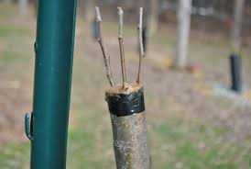
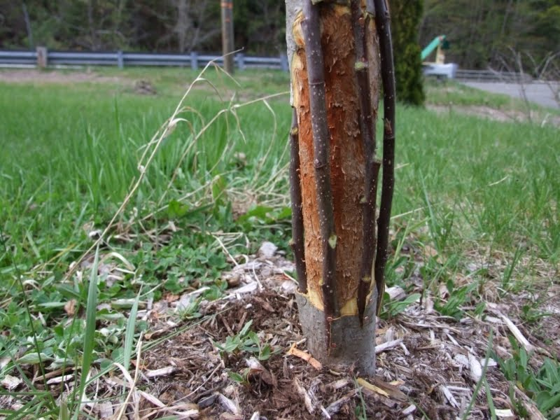
Top working and Repair
Top Working- The operation of cutting back the branches and top of an established tree and budding or grafting part of another tree on it.
Repair- Grafting parts of the tree onto an area that has been girdled or otherwise wounded by animal activity or human action (i.e. car crashes) to keep plant alive and viable.
Picture from gardenweb.com
Picture from http://eastbecketgardens.blogspot.com/
Notes:
Grafting can be done on much older plants with established roots
The image shown in the upper right is an example of topworking, while the image in the lower right shows a tree that has been girdled by animal activity and a bark graftage has been performed on it to maintain the flow of energry and resources between the seperated portions of the bark.

Slide 7
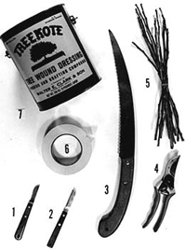
Check list for a successful graft and budding
Similar size for scion and rootstock
Sharp knife
Good cambium connection
Good tying
Warm moist conditions
Monitoring conditions during and following grafting
Image from http://www.extension.umn.edu/
Notes:
Budding and grafting in and of themselves are an art form in which craftsmanship is a vital component. Giving adequate attention to all steps of the process and a general attention to detail enhance the chance of performing a successful graft.

Slide 8
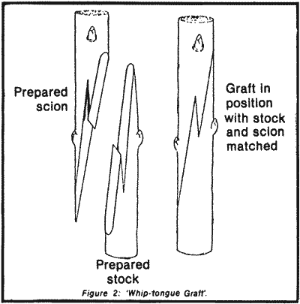
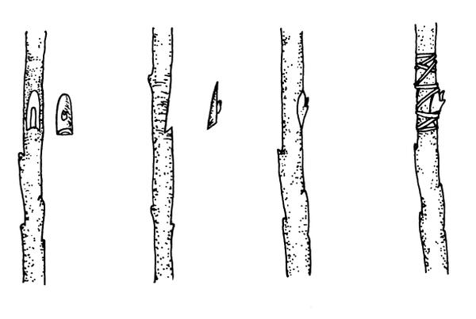
Grafts to be Performed on April 29th
Whip and Tongue Graft:
Picture from http://rfcarchives.org.au/Next/
Fruits/Mango/GraftingMangos11-84.htm
Chip Bud:
Picture from https://content.ces.ncsu.edu/
extension-gardener-handbook/
13-propagation

Slide 9
Good references
http://www.hort.cornell.edu/grafting/reasons/ReasonsGBLeft.html - Techniques for budding and grafting from Cornell university
Hartmann and Kester’s Plant Propagation: Principles and Practices
https://content.ces.ncsu.edu/grafting-and-budding-nursery-crop-plants- Techniques for budding and grafting from NC state coperative extension
https://www.youtube.com/watch?v=qTtXmBVsolY - video on top working
https://www.youtube.com/watch?v=885VGccSrvs- video on grafting
http://www.cumminsnursery.com - Nursery out of Auburn graters mecca

